Slide 1
Schedule…
Date | Day | Class No. | Title | Chapters | HW Due date | Lab Due date | Exam
17 Sept | Wed | 5 | Ohm’s Law | 2.6
18 Sept | Thu |  |  |  |  | LAB 1
19 Sept | Fri |  | Recitation |  | HW 2
20 Sept | Sat
21 Sept | Sun
22 Sept | Mon | 6 | Things Practical | 2.6 – 2.8 |  | LAB 2
23 Sept | Tue
24 Sept | Wed | 7 | Network Analysis | 3.1 – 3.2

Slide 2
Divided We Fall
Matthew 12:25-26
25 And Jesus knew their thoughts, and said unto them, Every kingdom divided against itself is brought to desolation; and every city or house divided against itself shall not stand:
Nephi 7:2
2 And the people were divided one against another; and they did separate one from another into tribes, every man according to his family and his kindred and friends; and thus they did destroy the government of the land.

Slide 3
Lecture 5 – Resistance & Ohm’s Law

Slide 4
Open and Short Circuits
Short circuit: a circuit element across which the voltage is zero regardless of the current flowing through it
Resistance approaches zero
Flow of current is unimpeded
ex: an ideal wire
In reality there is a small resistance
+
i
R = 0
v = 0
v
–

Slide 5
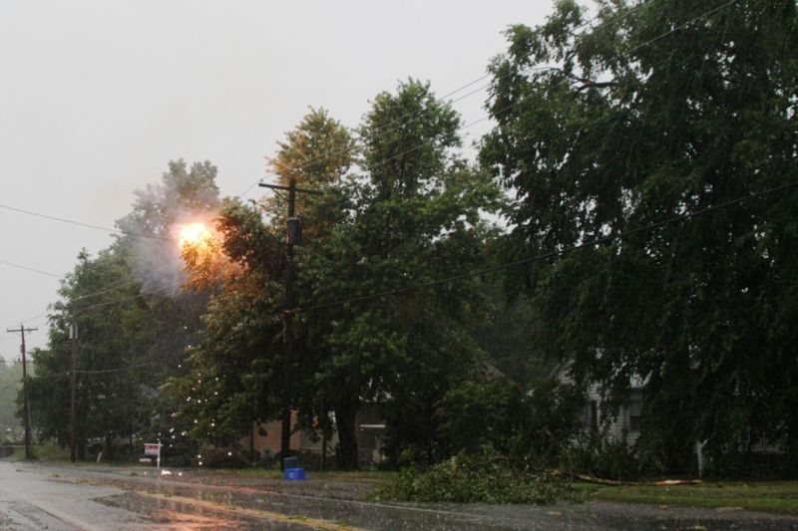
Open and Short Circuits
Undesirable short circuit – accidental connection between two nodes that are meant to be at different voltages. The resulting excessive current causes: overheating, fire, or explosion

Slide 6
Open and Short Circuits
Open circuit: a circuit element through which zero current flows regardless of the voltage applied to it
Resistance approaches infinity
No current flows
ex: a break in a circuit
At sufficiently high voltages arcing occurs
+
i
R ∞
i = 0
v
–

Slide 7
Open and Short Circuits
Example: What happens to R₂ and R₃ if R₁ is shorted?
V_{s} = 2V, R₁ = 2Ω, R₂ = R₃ = 4Ω, i₁ = 500mA
R₂ and R₃ = ¼ W rating, R₁ = ½ W rating
+ v₁ –
R₁
i₁
i₂
i₃
+
+
v₂
–
+
v₃
–
v_{s}
_
R₃
R₂

Slide 8
Open and Short Circuits
Example: What happens to R₂ and R₃ if R₁ is shorted?
V_{s} = 2V, R₁ = 2Ω, R₂ = R₃ = 4Ω, i₁ = 500mA
R₂ and R₃ = ¼ W rating, R₁ = ½ W rating
+ v₁ –
R₁
i₁
i₂
i₃
+
+
v₂
–
+
v₃
–
v_{s}
_
R₃
R₂

Slide 9
Open and Short Circuits
Example: What happens to R₂ and R₃ if R₁ is shorted?
V_{s} = 2V, R₁ = 2Ω, R₂ = R₃ = 4Ω, i₁ = 500mA
R₂ and R₃ = ¼ W rating, R₁ = ½ W rating
+ v₁ –
R₁
i₁
i₂
i₃
+
+
v₂
–
+
v₃
–
v_{s}
_
R₃
R₂

Slide 10
Open and Short Circuits
Example: What happens to R₂ and R₃ if R₁ is shorted?
V_{s} = 2V, R₁ = 2Ω, R₂ = R₃ = 4Ω, i₁ = 500mA
R₂ and R₃ = ¼ W rating, R₁ = ½ W rating
i₁
i₂
i₃
+
+
v₂
–
+
v₃
–
v_{s}
_
R₃
R₂
BAD! R₂ and R₃ are damaged

Slide 11
Series Resistors
Series Rule: two or more circuit elements are said to be in series if the current from one element exclusively flows into the next element.
From KCL: all series elements have the same current
R₁
R₂
R₃
R_{n}
R_{N}
∙ ∙ ∙
∙ ∙ ∙
R_{EQ}

Slide 12
Series Resistors
Demonstration of series rule: apply KVL and Ohm’s law on the circuit
i
+ v₁ –
R₁
+
+
v₂
–
V_{s}
_
1.5V
R₂
– v₃ +
R₃

Slide 13
Series Resistors
Voltage divider: the voltage across each resistor in a series circuit is directly proportional to the ratio of its resistance to the total series resistance of the circuit
NB: the ratio will always be <= 1

Slide 14
Series Resistors
Voltage divider: the voltage across each resistor in a series circuit is directly proportional to the ratio of its resistance to the total series resistance of the circuit
i
+ v₁ –
R₁
+
+
v₂
–
V_{s}
_
1.5V
R₂
– v₃ +
R₃

Slide 15
Series Resistors
Example1: Determine v₃
V_{s} = 3V, R1 = 10Ω, R₂ = 6Ω, R₃ = 8Ω
– v₁ +
i
R₁
+
v₂
–
+
V_{s}
_
R₂
+ v₃ –
R₃

Slide 16
Series Resistors
Example1: Determine v₃
V_{s} = 3V, R1 = 10Ω, R₂ = 6Ω, R₃ = 8Ω
– v₁ +
i
R₁
+
v₂
–
+
V_{s}
_
R₂
+ v₃ –
R₃

Slide 17
Parallel Resistors
Parallel Rule: two or more circuit elements are said to be in parallel if the elements share the same terminals
From KVL: the elements will have the same voltage
+
R₁
–
+
R₂
–
+
R₃
–
+
R_{n}
–
+
R_{N}
–
NB: the parallel combination of two resistors is often written: R₁ || R₂
+
R_{EQ}
–

Slide 18
Parallel Resistors
Demonstration of parallel rule: apply KCL and Ohm’s law on the circuit
Node a
+
v
–
i₁
i₂
i₃
+
R₁
–
+
R₂
–
+
R₃
–
i_{s}

Slide 19
Parallel Resistors
Current divider: the current in a parallel circuit divides in proportion to the resistances of the individual parallel elements
NB: the ratio will always be <= 1

Slide 20
Parallel Resistors
Current divider: the current in a parallel circuit divides in proportion to the resistances of the individual parallel elements
i₁
i₂
i₃
+
R₁
–
+
R₂
–
+
R₃
–
i_{s}
NB: it makes sense that the smaller the resistor, the larger the amount of current that will flow.

Slide 21
Parallel Resistors
Example2: find i₁
R₁ = 10Ω, R₂ = 2 Ω, R₃ = 20 Ω, I_{s} = 4A
i₁
i₂
i₃
–
R₁
+
–
R₂
+
–
R₃
+
i_{s}

Slide 22
Parallel Resistors
Example2: find i₁
R₁ = 10Ω, R₂ = 2 Ω, R₃ = 20 Ω, I_{s} = 4A
i₁
i₂
i₃
–
R₁
+
–
R₂
+
–
R₃
+
i_{s}

Slide 23
Parallel Resistors
Example2: find i₁
R₁ = 10Ω, R₂ = 2 Ω, R₃ = 20 Ω, I_{s} = 4A
i₁
i₂
i₃
–
R₁
+
–
R₂
+
–
R₃
+
i_{s}

Slide 24
Parallel Resistors
The parallel combination of resistors is often written:
For two resistors: R₁ || R₂
For three resistors: R₁ || R₂ || R₃
etc.
In each case R_{EQ} for the parallel combination must be found
+
R₁
–
+
R₂
–
+
R₁
–
+
R₂
–
+
R₃
–
+
R₁|| R₂
–
+
R₁|| R₂|| R₃
–

Slide 25
Parallel Resistors
Example3: find v
v_{s} = 5V, R₁ = 1kΩ, R₂ = 1kΩ
+ R₁ –
+
v
–
+
+
R₂
–
+
R₃
–
v_{s}
_
i_{s}

Slide 26
Parallel Resistors
Example3: find v
v_{s} = 5V, R₁ = 1kΩ, R₂ = 1kΩ
+ R₁ –
+ R₁ –
+
v
–
+
v
–
+
+
R₂
–
+
R₃
–
+
R₂ || R₃
v_{s}
_
v_{s}
_
i_{s}
i_{s}

Slide 27
Parallel Resistors
Example3: find v
v_{s} = 5V, R₁ = 1kΩ, R₂ = 1kΩ
+ R₁ –
+
v
–
+
R₂ || R₃
v_{s}
_
i_{s}

Slide 28
Parallel Resistors
Example3: find v
v_{s} = 5V, R₁ = 1kΩ, R₂ = 1kΩ
+ R₁ –
+
v
–
+
R₂ || R₃
v_{s}
_
i_{s}
NB: notice how R₃ controls v

Slide 29
Parallel Resistors
Example3: find v
v_{s} = 5V, R₁ = 1kΩ, R₂ = 1kΩ
+ R₁ –
+
v
–
+
R₂ || R₃
v_{s}
_
i_{s}
NB: notice how R₃ controls v

Slide 30
Parallel Resistors
Example3: find v
v_{s} = 5V, R₁ = 1kΩ, R₂ = 1kΩ
+ R₁ –
+
v
–
+
+
R₂
–
+
R₃
–
v_{s}
_
i_{s}
NB: notice how R₃ controls v

Slide 31
Parallel Resistors
Example3: find v
v_{s} = 5V, R₁ = 1kΩ, R₂ = 1kΩ
+ R₁ –
+
v
–
+
+
R₂
–
v_{s}
_
i_{s}

Slide 32
Parallel Resistors
Example3: find v
v_{s} = 5V, R₁ = 1kΩ, R₂ = 1kΩ
+ R₁ –
+
v
–
+
+
R₂
–
v_{s}
_
i_{s}

