Slide 1
Experimental Study on sheet metal bending with medium-power diode laser
Authors: M-L Chen, J. Jeswiet, P.J. Bates, G. Zak
September 20, 2010
Presented by: Kyle Petersen

Slide 2
Introduction
Through high-power laser irradiation, sheet metal can be formed by a laser-generated temperature gradient in the metal.
CO2 lasers have been used for metal forming for a while, but this study looks at using medium powered diode lasers (160 w) for sheet metal forming. There is currently very little information about the application of diode lasers in metal forming, thus the process characteristics of using a diode laser are investigated.

Slide 3
Its important because…
This experimental study on sheet metal bending with medium power diode lasers is furthering the research and knowledge base of using lasers in the manufacturing industry.
New and developing technologies must be tested to determine their applicability to modern manufacturing methods. In many cases this allows old methods to be replaced by faster, cheaper, and more versatile methods of manufacturing.

Slide 4
References
All these references are about Laser forming sheet metal. And the processes involved.
1 Martin, R. Automated adjusting in precision engineering
(German patent: Automatisiertes justieren in der
feinwerktechnik). Deutsches Patentamt, Offenlegungsschrift,
1979, 29 18 100.
2 Vollertson, F. Mechanisms and models for laser forming.
In Proceedings of the Laser assisted net shape engineering
Conference, 1994, pp. 345–359.
3 Geiger, M. and Vollertsen, F. The mechanisms of laser
forming. Ann. CIRP, 1993, 42(1), 301–304.
4 Geiger, M. Synergy of laser material processing and
metal forming. Ann. CIRP, 1994, 43(2), 563–570.
5 Vollertsen, F., Komel, I., and Kals, R. The laser bending
of steel foils formicroparts by the bulkling mechanism– a
model. Modelling Simulation Mater. Sci. Engng, 1995, 3,
107–119.
6 Arnet, H. and Vollertsen, F. Extending laser bending for
the generation of convex shapes. Proc. Instn Mech.
Engrs, Part B: J Engineering Manufacture, 1995, 209,
433–442.
7 Lawrence, J., Schmidt, M. J. J., and Li, L. The forming of
mild steel plates with a 2.5kW high power diode laser.
Int. J. Machine Tools Mf., 2001, 41, 967–977.
8 Hu, Z., Kovacevic, R., and Labudovic, M. Experimental
and numerical modeling of buckling instability of
laser sheet forming. Int. J. Machine Tools Mf., 2002,
42, 1427–1439.
9 Cheng, J. and Yao, Y. L. Process design of laser forming
for three-dimensional thin plates. J. Mfg Sci. Engng,
2004, 126, 217–225.
10 Ji, Z. and Wu, S. FEM simulation of the temperature
field during the laser forming of sheet metal. J. Mater.
Process. Technol., 1998, 74, 89–95.
11 Yu, G., Masubuchi, K., Maekawa, T., and Patrikalakis,
N. M. FEM simulation of laser forming of metal plates.
J. Mfg Sci. Engng, 2001, 123, 405–410.
12 Dearden, G. and Edwardson, S. P. Laser assisted forming
for ship building. SAIL, Williamsburg, VA. 2–4 June 2003.
13 Cheng, P. and Yao, Y. L . The influence of sheet metal
anisotropy on laser forming process. J. Mfg Sci. Engng,
2005, 127, 572–582.
14 Kim, J. and Na, S. J. Feedback control for 2D free curve
laser forming. Optics Laser Technol., 2005, 37, 139–146.
15 Namba, Y. and Yamaguchi, T. Laser forming of metals
using few-watt Nd:YAG lasers. In Proceedings of the
1998 International Symposium on Information theory,
CLEO/EUROPE’98, 14–18 September 1998.
16 Bachmann, F. Present status and future prospects of
high power diode and diode-pumped solid-state-laser
technology and applications in Germany. Report
from Rofin-Sinar Laser GmbH, Mainz, Germany,
http://219.163.176.20/photon2/pcenter_t/symposium/
2000pdf/p176.pdf.
17 Bachmann, F.G. and Russek,U. A. Laserwelding of polymers
using high power diode lasers. In Proceedings of the
Photonics West 2002 Conference, 22–24 January 2002.
These references are about FEM analisis, modeling, and simulation of laser metal forming.

Slide 5
References Cont.
18 Mayboudi, L. S., Chen, M., Zak, G., Birk, A. M., and
Bates, P. J. Characterization of beam profile for highpower
diode lasers with application to laser welding of
polymers. ANTEC, 2274, 2006.
19 Ready, J. F. Absorption of laser energy. LIA handbook of
laser materials processing, 2001, pp. 4–9.
20 Oberg, E., Jones, F. D., Horton, H. L., and Ryffel, H. H.
Machinery’s handbook, 25th edition, Industrial Press,
New York, 1996, pp. 1348, 1349, 1356.
21 Dearden, G. and Edwardson, S. P. Some recent developments
in two- and three-dimensional laser forming
for ‘macro’ and ‘micro’ applications. J. Optics A: Pure
and Applied Optics, 2003, 5, S8–S19.
22 Hannweber, J., Bonss, S., Brenner, B., and Beyer, E.
Integrated laser system for heat treatment with high
power diode laser. Proceedings of the 23rd International
Congress on Applications of lasers and electro-optics,
2004.
Experimental study on sheet metal bending 389
JEM951

Slide 6
Test equipment and materials
Laser used was a Rofin-Sinar DLx16 160 W diode laser
Setup in a UW200 workstation with an 18x18x12 movable work table. To which the specimen was attached.
Material to be tested was cold-rolled carbon steel, in three thicknesses. .25mm, .51mm, .79mm.
laser
specimen
Pneumatic cylinder

Slide 7
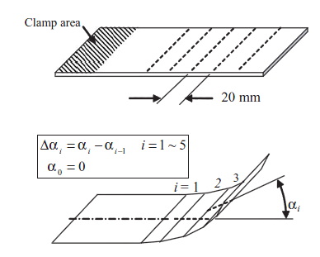
Test parameters
Material thickness
Laser beam width
(.6mm & 1mm)
Laser scan speed
(500, 750, 1000 mm/min)
Laser scan passes
(1, 2, 3, 4, 6, 8, 10, 15, 20, 30)

Slide 8
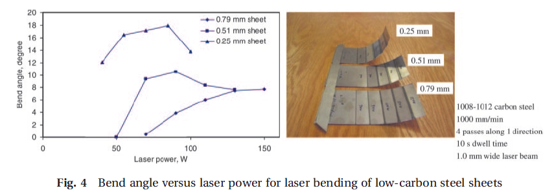
Results from test procedure
Material thickness
The .25 mm specimen did not
Return consistent results with
The higher power laser.

Slide 9
Laser beam width results

Slide 10
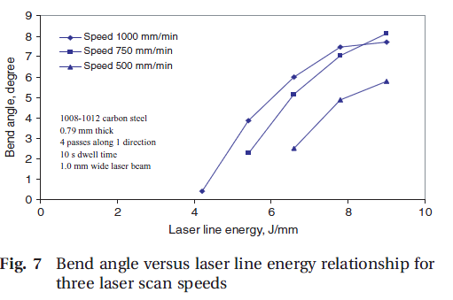
Laser scan speed

Slide 11
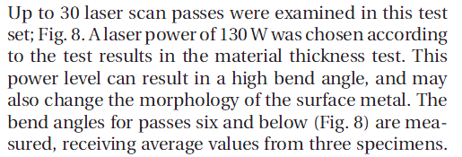
Laser scan passes

Slide 12
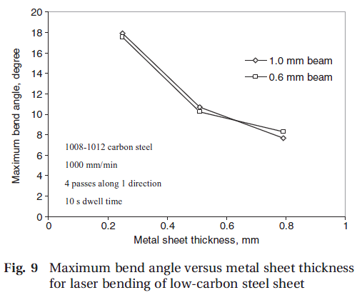
Analysis of the Results
From a bend angle point of view, regardless of the surface quality, a maximum bend angle and material thickness relationship can be drawn, as shown in Fig. 9, for both wide and narrow laser beam conditions. A relationship can also be drawn between the maximum bend angle and the ratio of laser beam width to sheet metal thickness

Slide 13
Laser beam width effects
Overall the width has little effect on the bend angle, but the surface appearances vary greatly depending on laser width and number of passes.

Slide 14
In conclusion
This test showed that a diode laser is an effective tool for laser forming of carbon steel sheets.
No additional surface coating is required.
Beam width to material thickness ratios played an important role in the resulting bend angle of the sheet metal.
This laser beam width study showed that the maximum bend angle depends mainly on the material thickness, not the power intensity distribution across the bend line for the given laser beam profile and material thickness range tested here.
A more evenly distributed laser beam is preferred to a sharp one for obtaining approximately the same bend angle but with less material property and surface appearance changes.
Laser bending is more effective in the initial number of passes. So, a multi-path bend strategy may be preferred for maximizing the total bend angle as well as reducing the bend surface morphology change.
Industries affected:
This technology could
impact virtually all
Manufacturing dealing
with sheet metal.
From ship building
to cell phones.

