Slide 1
Constant Jerk Trajectory Generator (TG)
Purpose:
This chapter introduces the ideal constant jerk S-curve (jerk is the derivative of acceleration), represented by a 2nd order polynomial in velocity. Its shape is governed by the motion conditions at the start and end of the transition.
An S-curve with an intermediate constant acceleration (linear portion) is often used to reduce the time to make large speed changes. The jerk can be used to determine how much of the rise or fall period can be made under constant acceleration.

Slide 2
In particular, you will
Determine why S-curves are necessary
Review the ideal S-curve.
Consider constant acceleration jerk transitions.
Consider the speed transition when the velocity change is too small to reach the desired accel (or decel) value.
Consider the trajectory generator in the context of joint moves or curvilinear moves.

Slide 3
Why S-curves?
v
2
3
The trapezoidal profile to the right was the trajectory generator of choice for many years, but is now being replaced by S-curve profiles. Why?
Area under curve is move distance
1
t
4
Reviewing the trapezoidal trajectory profile in speed v, we examine points 1, 2, 3, and 4. Each of these points has a discontinuity in acceleration. This discontinuity causes a very large jerk, which impacts the machine dynamics, also stressing the machine’s mechanical components.
An S-curve is a way to impose a limited jerk on the speed transitions, thus smoothing out the robot’s (or machine tool) motion.

Slide 4
Ideal S-curve
v
j
a_{s}
j_{m}
1
v_{s}
a_{r}
T/2
1
T
t
v_{o}
Convex
Concave
T/2
t = T
t

Slide 5
Ideal S-curve equations
The form assumed for the S-curve velocity profile is
v(t) = c_{o} + c₁t + c₂ t² (5.1)
giving the acceleration and constant jerk equations:
a(t) = c₁ + 2 c₂ t (5.2)
j(t) = 2 c₂ (5.3)
The rise motion can be divided into 2 periods - a concave period followed by a convex period.

Slide 6
Concave period
v
a_{s}
The concave conditions are
v(0) = v_{o}
a(0) = 0
a(T/2) = a_{s}
j(0) = j_{m}
where j_{m} is the jerk set for the profile (near the maximum allowed for the robot), and a_{s} is the maximum acceleration encountered at the S-curve inflection point.
1
v_{s}
a_{r}
1
v_{o}
Convex
Concave
T/2
t = T
t

Slide 7
Concave period
Applying the initial and final conditions, we get the equations for s (position), v, and a along the concave portion of the S-curve:
s(t) = v_{o} t + j_{m} t³/6 (5.7)
v(t) = v_{o} + j_{m} t²/2 (5.8)
a(t) = j_{m} t (5.9)
Note: It is assumed that s is 0 at the beginning of the S-move. Thus, s represents a position delta.

Slide 8
Ideal S-curve observations
If we let Δv = v_{s} - v_{o} and define a_{r} = Δv/T to be the acceleration of a constant acceleration ramp from v_{o} to v_{s}, then we note that a_{s} is twice a_{r}. It is also true that T = 2Δv/a_{s}.
The trapezoidal profile can be used to predict the time and distance required to transition the accel and decel periods of the ideal S-curve. This exercise is commonly called motion or path planning.

Slide 9
Convex period
This period applies for T/2 ≤ t ≤ T. Letting time be zero measured from the beginning of the convex period (0 ≤ t ≤ Τ/2), the pertinent motion conditions are:
v(0) = v_{h} = (v_{s} + v_{o})/2
a(0) = a_{s}
a(T/2) = 0
j(0) = -j_{m}
v
a_{s}
1
v_{s}
a_{r}
1
v_{o}
Convex
Concave
T/2
t = T
t
where -j_{m} is the jerk set for the profile, and a_{s} is the maximum acceleration encountered at the S-curve inflection point.

Slide 10
Convex period
Applying the initial and final conditions, we get the equations for s (position), v, and a along the convex portion of the S-curve:
s(t) = v_{h} t + a_{s} t²/2 - j_{m} t³/6 (5.11)
v(t) = v_{h} + a_{s} t - j_{m} t²/2 (5.12)
a(t) = a_{s} - j_{m} t (5.13)
Note: It is assumed that s is 0 at the beginning of the S-move. Thus, s represents a position delta.

Slide 11
Distance traversed
Adding in the distance at the halfway point gives the total distance traversed in the S-curve, including both concave and convex sections:
S = (v_{s}² - v_{o}²)/a_{s}

Slide 12
Max jerk transitions
An ideal S-curve cannot transition smoothly between any speed change using a specified max jerk value!
Why?

Slide 13
Max jerk transitions
Given a jerk j_{m}, a starting speed v_{o}, and the ending speed v_{s}, we can determine v₁ and v₂, where these are the velocities that end the concave transition and begin the convex transition at max accel a_{s} for the ideal S-curve transition:
v₁ = v_{o} + a_{s}²/(2j_{m})
v₂ = v_{s}- a_{s}²/(2 j_{m})
By setting v₁ = v₂, we can also determine the max jerk for a given a_{s} and Δv = v_{s} - v_{o}:
j_{m} = a_{s}² /Δv

Slide 14
Speed transitions
If v₁ > v₂ (overlap), we can determine an intermediate transition point using speed and acceleration continuity.
Note that the velocity and acceleration for the previous concave curve and the new convex curve must be equal at T_{t} where the velocity is v_{t}. We cannot reach the maximum acceleration a_{s} by applying maximum jerk transitions. Nevertheless, there exists a point where the concave profile will be tangent to the convex profile. This point will lie between v_{o} and v_{s}. At this point the acceleration and speed of both profiles are the same, although there will be a sign change in jerk.

Slide 15
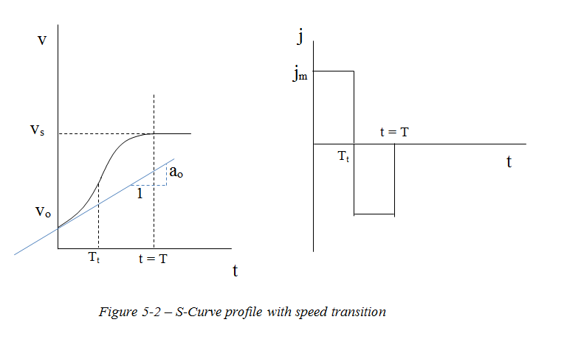
Speed transitions

Slide 16
Speed transitions
The pertinent equations are:
v_{o} + a_{o} T_{t} + j_{m} T_{t} ²/2 = v_{s}- j_{m} (T - T_{t})²/2 (5.20)
a_{o} + j_{m} T_{t} = j_{m} (T - T_{t}) (5.21)
Solving these we get:
T = [-a_{o} + sqrt( 2 a_{o}² + 4 Δv j_{m}) ]/ j_{m} (5.22)
T_{t} = (j_{m} T - a_{o})/(2 j_{m}) (5.23)
where Δv = (v_{s} - v_{o}).

Slide 17
S-curve with linear period
If v₁ < v₂, then we must insert a linear (constant acceleration) period. The desired maximum S accel (a_{s}) is known, as is the maximum jerk (j_{m}).
v
j
a_{s}
j_{m}
v_{s}
1
a_{r}
T-t₁
t = T
1
t₁
t
v_{o}
t₁
t = T
t
S-Curve profile with linear period

Slide 18
S-curve with linear period
Motion conditions:
Phase 1 - Concave Phase 2 – Linear Phase 3 - Convex
0 ≤ t ≤ t₁ 0 ≤ t ≤ T -2t₁ 0 ≤ t ≤ t₁
_________________________________________________________________________________________________________________
v(0) = v_{o}
a(0) = 0
a(t₁) = a_{s}
j(0) = j_{m}
v(t₁) = v₁
v(0) = v₁
a(0) = a_{s}
a(T-2t₁) = a_{s}
v(T-2t₁) = v₂
v(0) = v₂
a(0) = a_{s}
v(t₁) = v_{s}
a(t₁) = 0
j(0) = - j_{m}

Slide 19
S-curve with linear period
Phase 1 – Concave motion conditions:
s(t) = v_{o} t + j_{m} t³/6 (5.25)
v(t) = v_{o} + j_{m} t²/2 (5.26)
a(t) = j_{m} t (5.27)

Slide 20
S-curve with linear period
Phase 2 – Linear motion conditions:
s(t) = v₁ t + a_{s} t²/2 (5.30)
v(t) = v₁ + a_{s} t (5.31)

Slide 21
S-curve with linear period
Phase 3 – Convex motion conditions:
s(t) = v₂ t + a_{s} t²/2 - j_{m} t³/6 (5.35)
v(t) = v₂ + a_{s} t - j_{m} t²/2 (5.36)
a(t) = a_{s} - j_{m} t (5.37)

Slide 22
S-curve context
How is the S-curve applied in the real world?
Robots and machine tools are commanded to move in either joint space or Cartesian space.
In joint space the slowest joint becomes the controlling move. Its set speed and joint distance is used for the trajectory motion planning. Desired acceleration and jerk values are applied for this joint to specify the S-curve profiles.
In Cartesian space either the path length or tool orientation change dominates the motion. The associated speeds , accelerations, and jerk values specify the S-curve profiles. The trajectory generator processes length or orientation change, whichever is dominant. The other change is proportioned.

Slide 23
TG summary
S-curve is used to smooth speed transitions by eliminating points of extremely high jerk.
S-curve is limited by jerk and acceleration settings, and also by desired speed change.
The equations that govern the decel period of the TG are similar to the accel period, but use a negative acceleration setting.
The S-curve profiles can be applied to joint moves or to Cartesian moves.

