Slide 1
Introduction To Robotics By Ed Red
“A robot is a re-programmable, multi-functional manipulator designed to move material, parts, tools, or specialized devices through variable programmed motions for the performance of a variety of tasks.” (Robotics Institute of America)

Slide 2
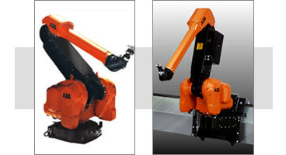
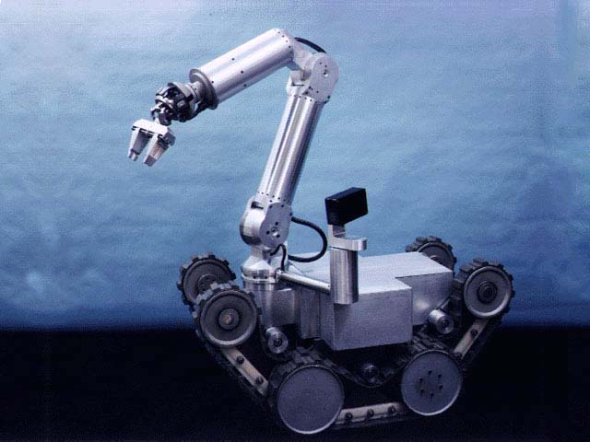
Robot Function
Generate specific motion of joints
Integrate tooling and sensors
Robot Processes
Path following
Repetitive configuration moves
Telerobotics
Target moves versus taught moves

Slide 3
Key Terms
Repeatability - Variability in returning to the same previously taught position/configuration
Accuracy - Variability in moving to a target in space that has not been previously taught
Tool speed - Linear speed capability when tool moving along a curvilinear path
Screw speed - Rotational speed when tool is being rotated about an axis in space
Joint interpolated motion - Motion where joint taking longest time to make the joint change governs the motion and the other joints are slowed in proportion so that all joint accomplish their joint changes simultaneously with the slowest joint

Slide 4
Key Terms (cont...)
TCF - Tool or terminal control frame
TCP - Tool /terminal control point
Joint limits - Either the software or physical hardware limits which constrain the operating range of a joint on a robot. The software limits have a smaller range than the hardware limits.
Joint speed limits - Speed limit for robot joints, which limit how fast the links of a robot may translate or rotate.
Point-to-point motion - Characterized by starting and stopping between configurations or as the tool is moved between targets.

Slide 5
Key Terms (cont..)
Continuous path motion - Characterized by blending of motion between configurations or targets, usually with the loss of path accuracy at the target transitions, as the robot moves between configurations/targets.
Interpolation (kinematic) capabilities - Robot usually capable of both forward and inverse kinematics. Both combine to give the robot the capability to move in joint space and in Cartesian space. We typically refer to the moves as joint, linear, or circular interpolation.
Forward kinematics - Specifying the joint values to accomplish a robot move to a new configuration in space. These may not be simple as it seems because secondary joints such as four-bar linkages, ball screws, etc. may be required to accomplish this motion.

Slide 6
Key Terms (cont..)
Inverse kinematics - Solving a mathematical model of the robot kinematics to determine the necessary joint values to move the tool to a desired target (frame) in space. This is accomplished by frame representation whereby a triad (xyz axes) is attached to the tool on the robot and a target frame is attached to the part or operating point in the workcell. The inverse kinematics determine the joint values required to align the tool triad with the target triad.
I/O - Input/output which consist of ON/OFF signal values, threshold values, or analog signal values which allow the control of or response to external devices/sensors as required to sequence workcell operations.
Programming language - The language and logical constructs used to program the set of operational instructions used to control robot movement and interact with sensors and other cell devices.
Multi-tasking - Ability to process more than one program at a time or process I/O concurrently.

Slide 7
Key Terms (cont..)
Load capability - Force and torque capability of the robot at its tool interface
Teach Pendant - Operator interface device used to teach/save robot configurations and program simple instructions.

Slide 8
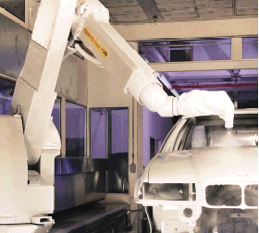
Where Used and Applied
Welding
Painting
Surface finishing
Aerospace and automotive industries
Light assembly such as in the micro-electronics industries, or consumer products industries
Inspection of parts (e.g., CMM)
Underwater and space exploration
Hazardous waste remediation

Slide 9
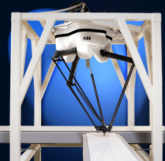
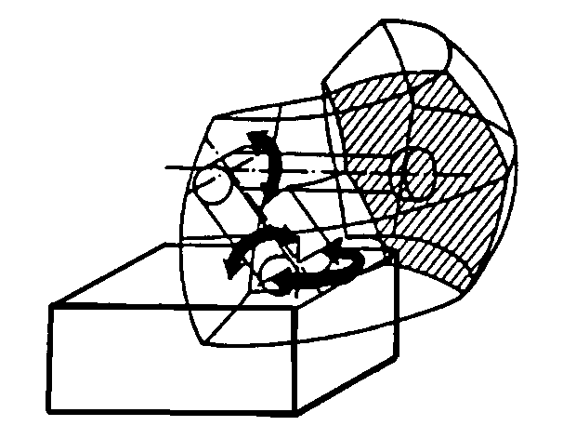
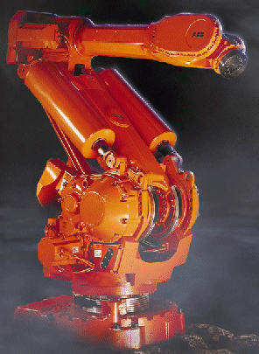
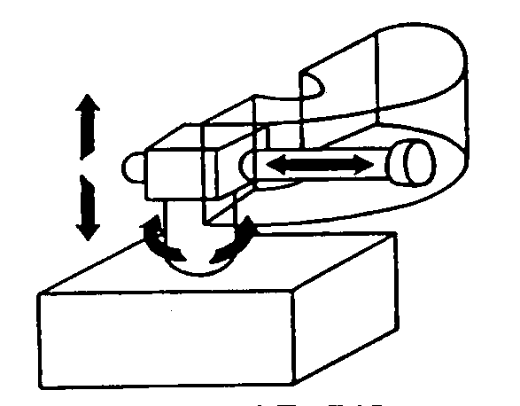
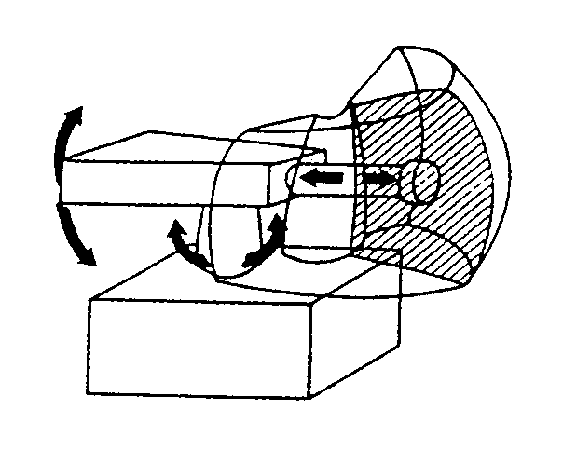
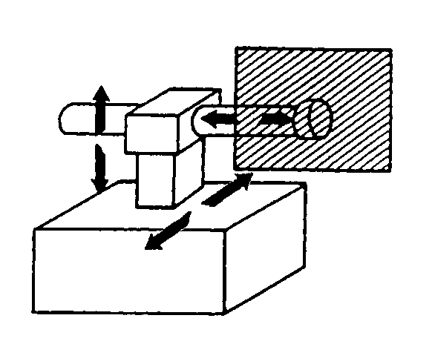
Robot Types
RRR
RPP
Revolute
Cylindrical
RRP
PPP
Spherical
Rectangular

Slide 10
Primary Vendors
· Fanuc (Japan) · Kuka (Germany)
· ABB (Sweden, US) · Adept (US)
· Panasonic (Japan) · Seiko (Japan)
· Sankyo (Japan) · Motoman (Japan)
· Mitsubishi (Japan)
Typical Costs: $20 K - $80 K

Slide 11
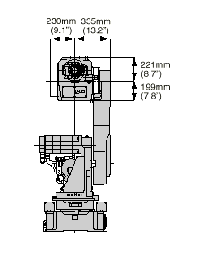
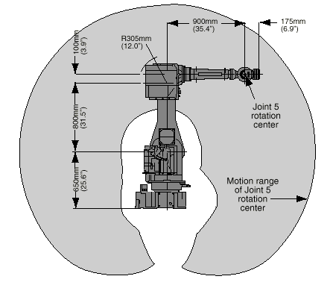
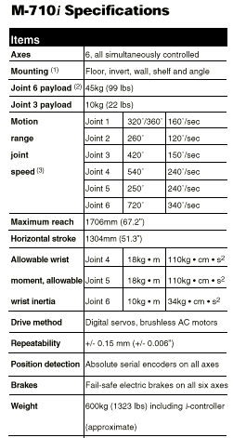
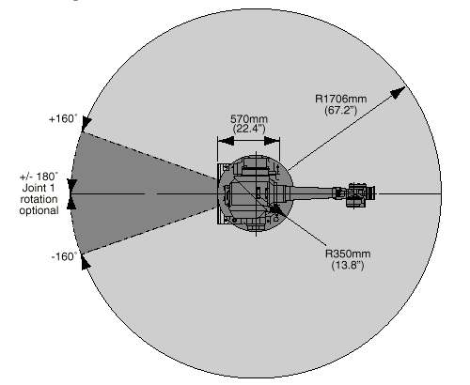
Vendor Specifications

Slide 12
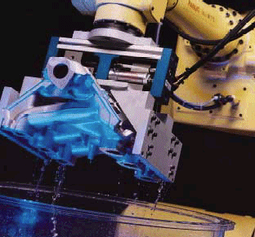
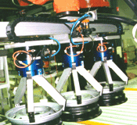
Supporting Technologies
· Vision systems · End-of-arm tooling · Compliance devices · Manipulation devices · Welding technologies · Lasers · Proximity sensors · Wrist sensor (forces/torques) · Control software/hardware · Part delivery systems · Application software · Interface software · Operating systems · Programming languages · Communication systems · I/O devices

Slide 13
Advantages
Greater flexibility, re-programmability, kinematics dexterity
Greater response time to inputs than humans
Improved product quality
Maximize capital intensive equipment in multiple work shifts
Accident reduction
Reduction of hazardous exposure for human workers
Automation less susceptible to work stoppages

Slide 14
Disadvantages
Replacement of human labor
Greater unemployment
Significant retraining costs for both unemployed and users of new technology
Advertised technology does not always disclose some of the hidden disadvantages
Hidden costs because of the associated technology that must be purchased and integrated into a functioning cell. Typically, a functioning cell will cost 3-10 times the cost of the robot.

Slide 15
Limitations
Assembly dexterity does not match that of human beings, particularly where eye-hand coordination required.
Payload to robot weight ratio is poor, often less than 5%.
Robot structural configuration may limit joint movement.
Work volumes can be constrained by parts or tooling/sensors added to the robot.
Robot repeatability/accuracy can constrain the range of potential applications.
Closed architectures of modern robot control systems make it difficult to automate cells.

Slide 16
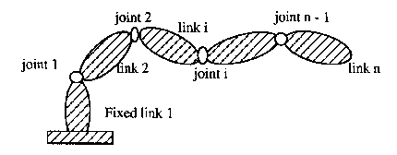
Robot Kinematics
Open kinematics chain
Degrees-of-freedom = # independent joints (normally)
Other joints often used to drive independent joints
Joints often have functional relationships
Forward kinematics -> Joint space
Inverse kinematics -> Cartesian space
Z₃
Z₂
Z₁

Slide 17
Homogeneous Transformation
y
Y
p
x
z
X
Z
Notes: 1. In robotics d = 0 2. p = origin of xyz relative to XYZ 3. Three columns of R are direction cosines of x, y, z with respect to X, Y, and Z, e.g., R(1,2) = cosine of angle between y and X. 4. If xyz aligned with XYZ, then R = I = identity matrix. 5. If rotation only then p = 0 = zero vector.

Slide 18
Interpretation of Homogeneous Transformation
Z
z
Y
200
y
100
x
X

Slide 19
Example
Can you show that H from the previous slide is the same as H(p) H(z,90˚)where frame xyz is first offset from the base frame by p = [200 100 0]^{T}, followed by a 90˚ rotation applied about the frame (or body) z axis?
H = H(p) H(z, 90˚)

Slide 20
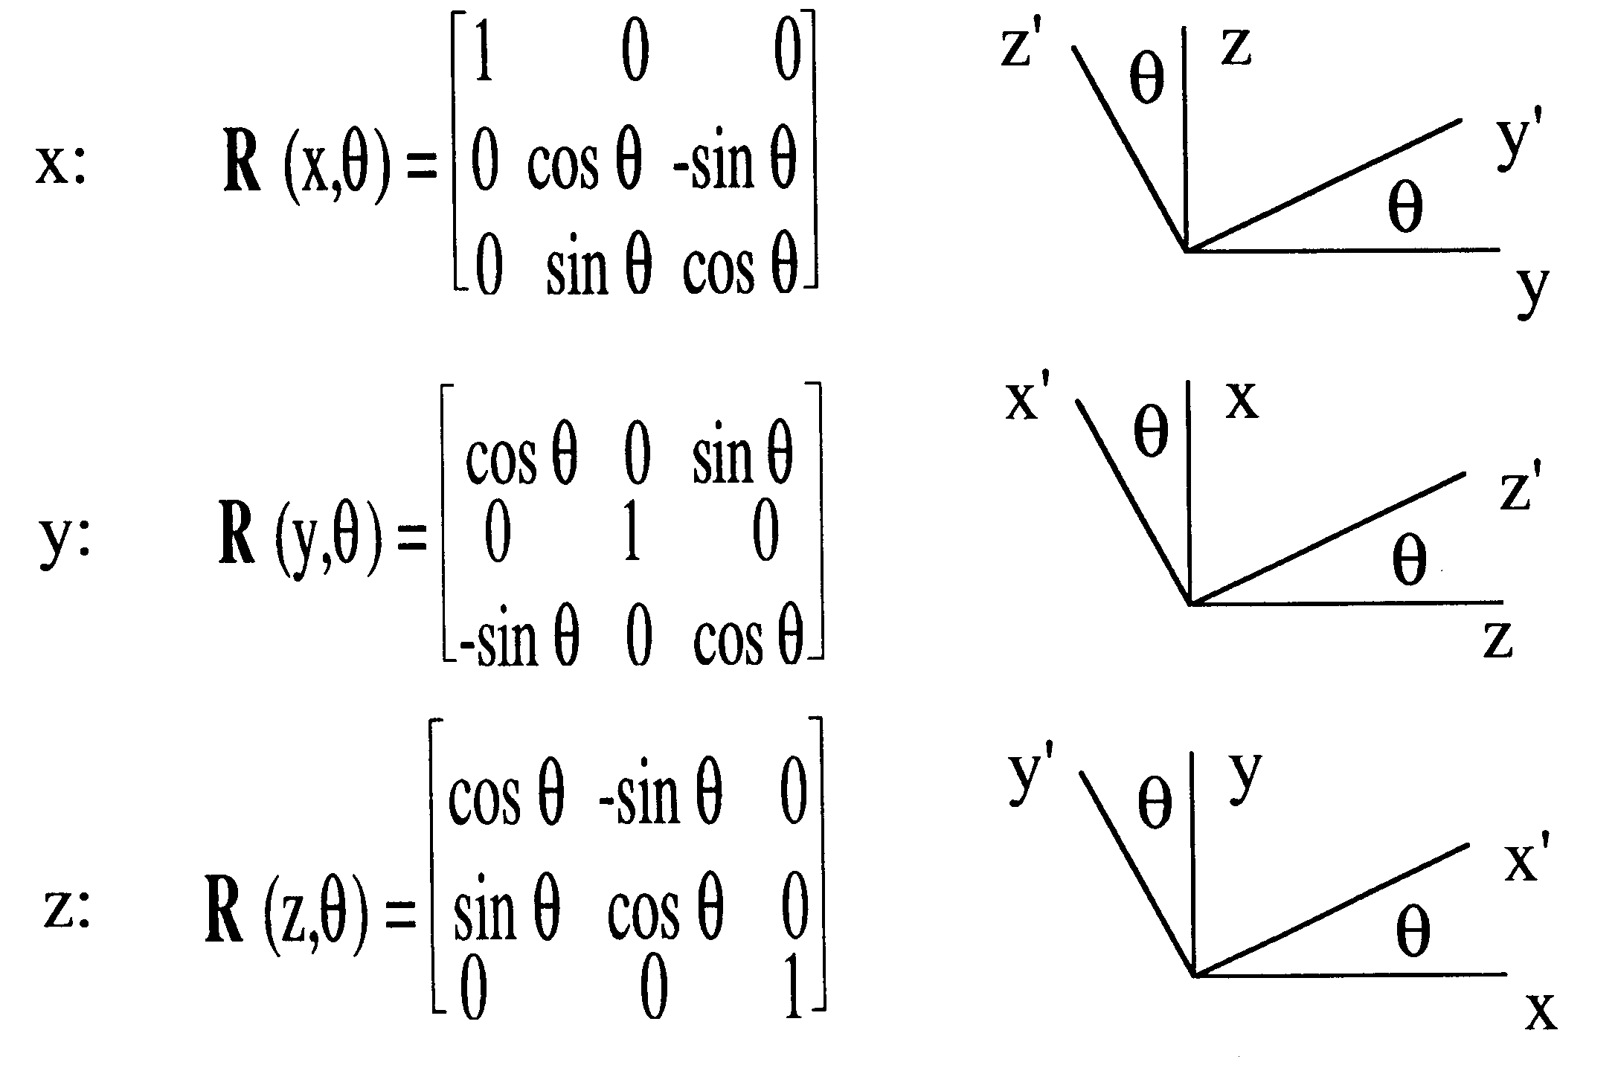
Rotation Transformations
Rotation about single axis:

Slide 21
Transferring/Resolving Vectors
Transfer v to XYZ by
u = H v
where
y
Y
v
u
x
u_{x} u_{y} u_{z} 1
v_{x} v_{y} v_{z} 1
p
z
u =
v =
X
Z
Note: To resolve v into the base frame only the 3x3 R matrix should be used and the 1 dropped off the v vector.

Slide 22
Example of resolving vectors
Rotate u = [0 1 0]^{T} by 90˚ CW (-) about Z and 90˚ CW (-) about Y (note that both rotations are about base axes). What are the final coordinates in XYZ axes? If rotation order is changed, will the final coordinates be the same?
Solution:
v = R (Z, -90˚) u
w = R (Y, -90˚) v
Thus,
w = R (Y, -90˚) R (Z, -90˚) u
Rotations are not commutative, thus final coordinates will not be the same!

Slide 23
Relative Transformations
If we post-multiply a transformation representing a frame by a second transformation, we make the transformation with respect to the frame axes of the first transformation. Pre-multiplying the frame transformation by the second transformation causes the transformation to be made with respect to the base reference frame.

Slide 24
Kinematics Loop
Forward*: T = H₁ H₂…H_{i}…H_{n} G
Inverse*: H₁ H₂…H_{i}…H_{n} = TG⁻¹ …..complex solution!
*Note that H_{i} is a function of joint variable; thus, 6 joints, 6 joint variables!

Slide 25
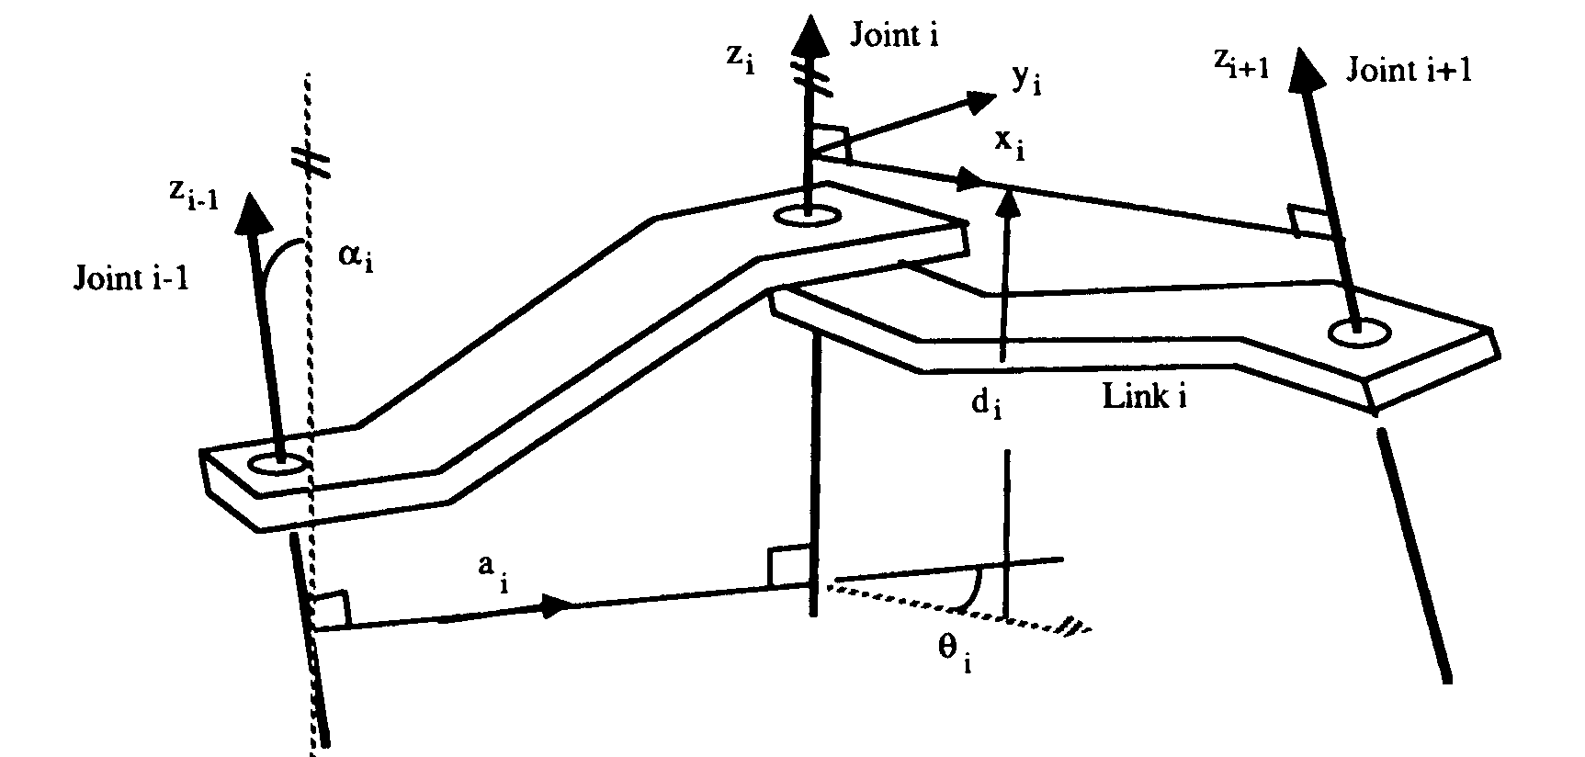
Forward Kinematics
Homogeneous transformations can be described in Denavit-Hartenberg (D-H) coordinates which only requires 4 parameters to pose one frame relative to another. In these coordinates the z axis is always aligned along the joint axis.
D-H parameters: a_{i} = minimum distance between joint i axis (z_{i}) and joint i-1 axis (z_{i-1}) d_{i} = distance from minimum distance line (x_{i-1} axis) to origin of ith joint frame measured along z_{i} axis. α_{i} = angle between z_{i} and z_{i-1} measured about previous joint frame x_{i-1} axis. θ_{i} = angle about z_{i} joint axis which rotates x_{i-1} to x_{i} axis in right hand sense.

Slide 26
Joint Interpolated Motion
Examine each joint for the changes in joint angles.
Estimate the time to accomplish each joint change at the speed setting, given the speed allowed for each joint.
Determine the joint which will take the longest time to accomplish the joint change.
Slow the remaining joints down so that all accomplish their change in the same period.
The joint interpolated setting is usually a number between 0 and 1 which represents the fractional % of full speed for each joint.

Slide 27
Example
A simple mechanism has two joints described as follows:
Joint 1: Joint 2: Type = Prismatic (sliding) Type = Revolute (rotational) Joint speed maximum = 100 mm/s Joint speed maximum = 180˚/s
If the robot joint speed setting is set to 50%, then approximate the time to move from a configuration of 20 mm, 125.3˚ to a configuration of 134.5 mm, 34.5˚, and also determine the joint speeds in doing so. Which joint is controlling the motion and which is following the motion? Neglect the acceleration and deceleration times.
Solution:

Slide 28
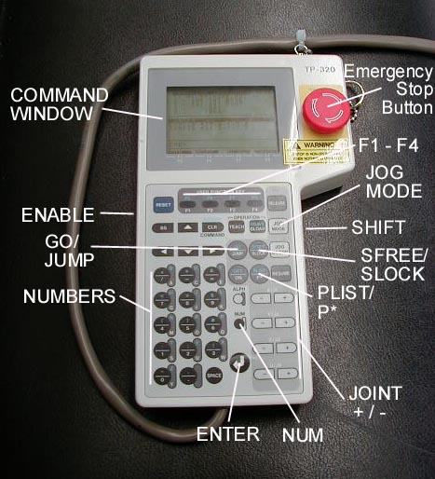
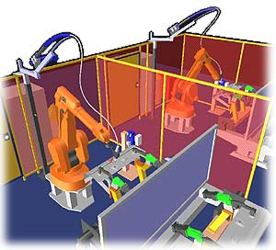
Robot Programming
· Teach Pendant
· Lead Through
· Off-Line
· Programming Languages:
DARL VAL II RAIL AML KAREL Robpac/C etc.

Slide 29
Standards
Robotics Industries Association (RIA)
SME/RI
Typical areas covered:
- Definitions such as accuracy/repeatability - Teach pendant safety regulations - Controller wiring

Slide 30
Summary
Robotics - integration of computers and controlled mechanisms to make devices re-programmable and versatile.
Modern mathematic representations are used to plan robotic tasks and integrate sensors into the task planning.
There are decided advantages to using robots, namely flexibility and performance quality.
Down side is that robotics effects the labor pool and increases the educational requirements for manufacturing personnel.
Robotics are used in most industries and will be used even more in the decades to come.

