Slide 1
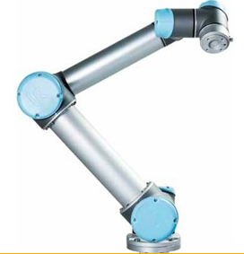
UR5: Universal Robots
April 18 2013
Brian Marler

Slide 2
Introduction of Application Relation to Technical Area in ME 537
The targeted purpose of the UR5 is to make these robots VERY easy to use, install, and work around.
Programming a robot in code is an intensive and time-consuming task, as most of us know. This robot can be both installed and programmed in under an hour.
http://www.universal-robots.dk/DK/Video-Product.aspx

Slide 3
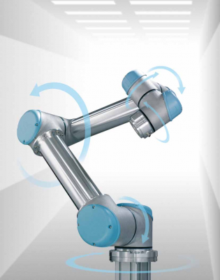
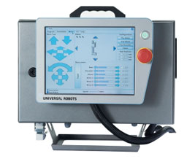
Results - Equipment
1. Low Cost
2. Does not require any safety fencing (“Cage-Free”)
3. Portable/very easy setup
capable of linear motion
+/- 360 degrees of motion on all axis
Capable of being equipped with many different tools
Low noise and power
Tablet controlled
18 kg total weight
http://www.universal-robots.dk/DK/Video-Torso.aspx

Slide 4
Results - Process
The process is very simple
1. install/move the robot where it is needed
2. program the movements
using the 12-inch touchscreen to create programs
Using the teach pendent
3. hit Run

Slide 5
Results - Limitations
Payload: 5 Kg
Range:85 cm
Speed:
Joint: Max 180°/sec.
Tool: Approx. 1 m/sec.
Repeatability: +/- 0.1 mm
Will not push with more than 150 Newtons
Specification Sheet
http://media1.limitless.dk/UR_Tech_Spec/UR5_GB_2012.pdf

Slide 6
Results - Limitations

Slide 7
Results - Costs
The UR5 cost 25,000 dollars and the estimated ROI is 6 months
Time to install UR5: under 30 minutes
Time to program: Under 20 minutes
Injury costs: Very low

Slide 8
Conclusion Practical Industrial Use
Can be used in practically all industries, from small start-up companies to large industrial plants
http://www.universal-robots.dk/DK/Video-Showcase.aspx
Aerospace
Automotive
Building materials
Electronics
Beverage,
Manufacturing
Medical
Newspaper
Plastics
Printing applications

Slide 9
Conclusion Technical Advancement
Very intuitive and simple to use user-interface
Very big deal
All of our calculations (Jacobian, homogenous transformations, inverse kinematics, estimating joint torques, etc) are pre-programmed in. We never see them behind the User Interface
Mobility of robot (can be placed anywhere safely)
Safety of robot (“Cage-Free”)

Slide 10
Conclusion Industries Most Impacted
I believe the industries most impacted are small companies in every industry.
These robots are basic, easy to use, versatile robots.
Highly skilled workers are unnecessary.
Install almost anywhere due to its Cage-Free safety

