Slide 1
Home Automation Automation Examples
Matt Harris
9/28/12

Slide 2
Goals of Home Automation
Increase comfort of your home
Decrease effort required to perform menial tasks
Ease of living for elderly
Home security
Increase efficiency of power usage in the home
Feel more “in control”
Show off to your friends!

Slide 3
Current State of Home Automation
Apps
Exist for i-Phone, Android, and others
Control your home from anywhere you have service
No remote to keep track of or lose
Connect to security system for paranoid-types
Panels
Remotes
Individual modules

Slide 4
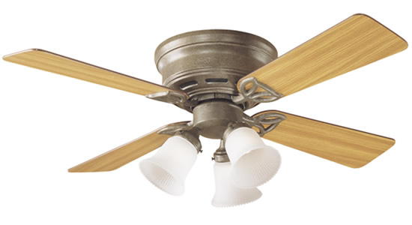
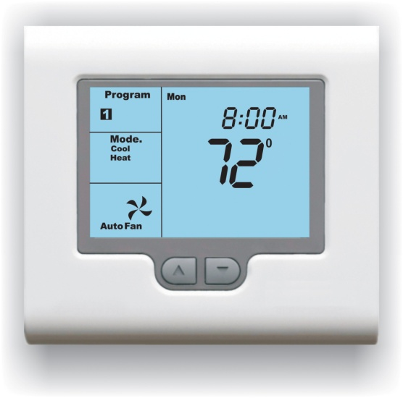
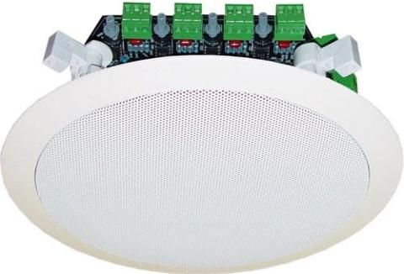
Where Used
Lights, blinds, fans
Appliances, entertainment systems
Alarms, locks, garage doors, security
Heating and air conditioning
Home theaters, in-house sound
Sprinklers, phones and intercoms

Slide 5
Demographics
Very rich/Elite
“Smart homes”
Voice commands, motion sensors, automatic changes
Generally highly integrated, controllable from mobile device
Middle class
Different levels of automation
Prebuilt or aftermarket wired or wireless
Less integrated, more specific with control panels, etc.
Cheapest are simple on/off switches connected to a remote control (the clapper)

Slide 6
Cost
High-end systems prebuilt into home
Range from $10,000 to $50,000 (not counting some electronics)
In-house sound in every room, total connectivity, mobile control.
Remembers to feed the dog for you, knows where you left your keys
Mid-range systems
About $100 per module
Total cost between $1,000 and $10,000
Expandable to include more systems later
Low-end systems
About $15-30 per module
Total cost between $100 and $1000
Generally not expandable beyond a certain number of modules
Category could include Clappers and Garage door openers as stand-alone systems

Slide 7
Supporting Technology

Slide 8
Supporting Technology

Slide 9
Supporting Technology

Slide 10
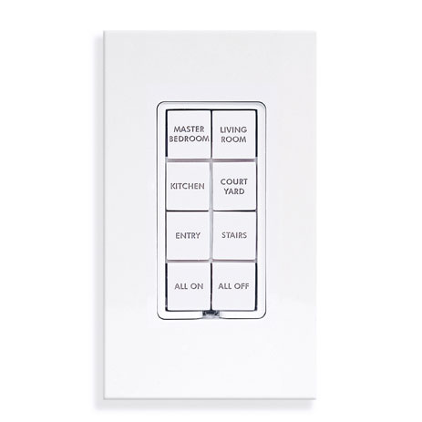
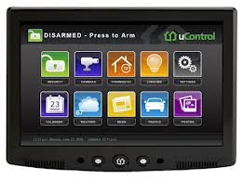
Application Rules, Limitations
Has to look good
User interface should be highly intuitive
Needs to be reliable within the expected range
Extent of automation limited by cost (for most)
Lower end products are not very reliable
Can be security risk if your phone is stolen

Slide 11
Primary Vendors of Technology
mControl
HomeSeer
PowerHome
Control4
Vivint
ActiveHome Pro
Crestron (BYU OIT)

Slide 12
Existing or Evolving Standards
X10 (Powerline)
UPB (Powerline)
Z-wave (RF)
Insteon (RF and Powerline)
Zigbee (RF)
Miniservers (direct control with logic program)

Slide 13
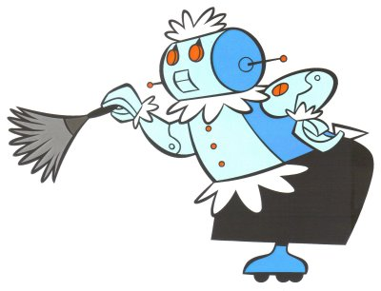
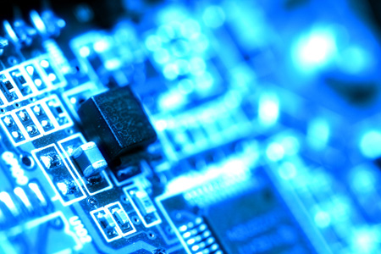
Technical Paper
“Home Automation” Electronics & Communication Engineering Journal

Slide 14
Class Application
A mini-server is essentially a PLC device.
Build a ladder logic diagram to control your blinds
Include a parental control that can lock the blinds
| P1 C2 X1 C1 | Where P1 is the
|----[/]----[/]----[ ]----( )----| Parental control,
| | X1 is up button
| P1 C1 X2 C2 | X2 is down button
|----[/]----[/]----[ ]----( )----| C1 is up motor
| | C2 is down motor

Slide 15
References
“Home Automation” Electronics & Communication Engineering Journal Jul/Aug 1989, Vol. 1, Iss. 4, pg 185
http://www.maximumpc.com/article/the_high_cost_of_home_automation
http://homes.yahoo.com/news/5-high-tech-smart-homes-for-the-supe
http://www.cnet.com/1990-10839_1-6224211-1.htmlr-rich.html?page=all
http://www.homeauto.com/Products/Price/WhatDoesThisCost.asp
http://expert-corner.com/2010/05/disadvantages-of-home-automation/
http://www.scoop.it/t/home-automation
http://www.automatedhome.co.uk/New-Products/Loxone-Miniserver-Home-Automation-Controller.html
http://www.loxone.com/pages/de/default.aspx
http://home-automation-systems-review.toptenreviews.com/
http://fireflyintegrations.com/products/crestron-electronics/
http://www.smarthome.com/INSTEON_comparison.html
http://www.liveautomatic.com/reviews/insteon-vs-x10-zigbee-and-zwave
http://en.wikipedia.org/wiki/Ladder_logic
http://en.wikipedia.org/wiki/Home_automation

