Slide 1
Temperature of a 100 W Light Bulb Filament
Joran Booth and Peter Hyatt
ME 340
Winter 2009

Slide 2
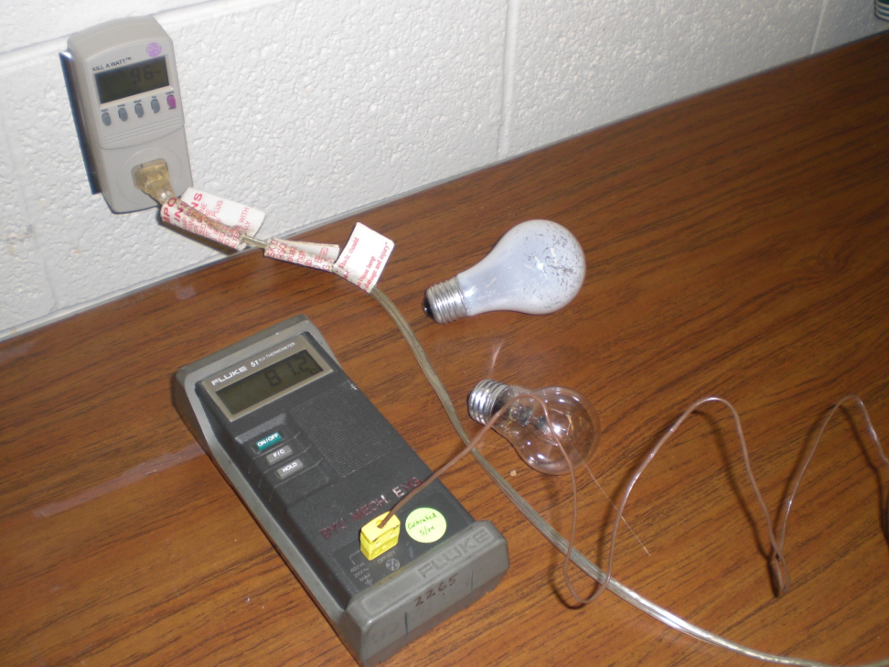
Heat Transfer Problem
Measured the electrical power dissipated
Measured the bulb surface temperature and the ambient temperature
Measured the diameter of the light bulb
Measured the thickness of the glass
Assumptions:
Near vacuum inside the light bulb
Geometry is a sphere
The radiation is a point source
Filament treated as a sphere
All electrical work converted to heat

Slide 3
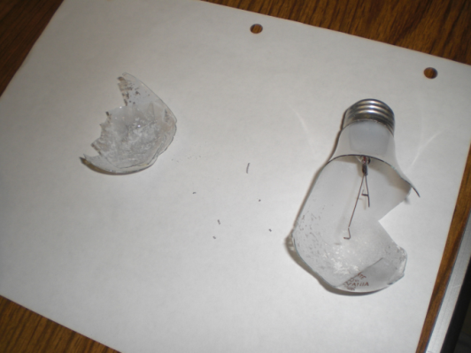
Solution
T_{avg} | ρ | c_{P} | μ | ν | k | α | Pr | beta
332 | 1.0549 | 1008 | 2.00E-05 | 1.91E-05 | 2.87E-02 | 2.72E-05 | 0.703 | 3.01E-03
Ø_{fil} = | 0.06149 | σ = | 5.67E-08 | h_{r1} = | 481.0875139 | R₁ = | -0.0434
Ø_{inner} = | 0.0595 | Tin = | 368 | h_{r2} = | 8.111165792 | R₂ = | 7.00E-01
Ø_{outer} = | 0.06 | T_{S} = | 368 | h = | 6.56E+00 | R₃ = | 0.00028
k_{N} = | 2 | T∞ = | 300 | Nu = | 13.71767276 | R₄ = | 53.901
k_{glass} = | 81 | q = | 96 W | Ra = | 8.34E+05 | R₅ = | 43.6038
A_{fil} = | 0.00283 | ε_{glass} = | 0.95 |  |  | R_{total} = | 24.8045 | without R1
A_{glass} = | 2.97E-03 | ε_{W} = | 0.38 |  |  | T_{filament} = | 2681 | K
 |  | Ts = | 2681
T_{s} = 95ºC
T_{filament}= ?
k_{nitrogen}
= 81 W/m·K
A_{s}, ε
Vacuum
60 mm Ø
0.5 mm thick
Glass
Online sources show: T = 2550ºC
q_{in} = 96 W

Slide 4
Results

Slide 5
Conclusions and Recommendations
The temperature is between 4500 to 2500˚C.
Main contributors to T_{filament}:
Surface Area of Filament
Vacuum v. Conduction thru gas
Measure different filament styles
Verify/modify assumptions with other measurements

Slide 6
Appendix
http://answers.yahoo.com/question/index?qid=20080508134327AAlv437 .
Fundamentals of Heat and Mass Transfer, Incropera, 6th Edition.
http://members.misty.com/don/bulb1.html

Slide 7
Additional Graphs
Both graphs based on assumption of pure nitrogen inside bulb with no convection

Slide 8
Calcuations
Assuming a vacuum
A1 = | 2.97E-03 | ε1 = | 0.38 | Ts = | 2681 | K | A1 = | 2.97E-05 | ε1 = | 0.38 | Ts = | 4316 | K | A1 = | 2.97E-07 | ε1 = | 0.38 | Ts = | 11709 | K
 |  | Ts = | 2681 |  |  |  |  |  | Ts = | 4320 |  |  |  |  |  | Ts = | 11690
A1 = | 2.97E-05 | ε1 = | 0.38 | Ts = | 4316 | K | A1 = | 2.97E-05 | ε1 = | 0.27 | Ts = | 5010 | K | A1 = | 2.97E-05 | ε1 = | 0.18 | Ts = | 4983 | K
 |  | Ts = | 4320 |  |  |  |  |  | Ts = | 4320 |  |  |  |  |  | Ts = | 4984
Assuming nitrogen filled
A1 = | 2.97E-03 | ε1 = | 0.38 | Ts = | 2615 | K | A1 = | 2.97E-05 | ε1 = | 0.38 | Ts = | 2643 | K | A1 = | 2.70E-07 | ε1 = | 0.38 | Ts = | 2934 | K
 |  | Ts = | 2615 |  |  |  |  |  | Ts = | 2643 |  |  |  |  |  | Ts = | 2933.96
A1 = | 2.97E-05 | ε1 = | 0.38 | Ts = | 2643 | K | A1 = | 2.97E-05 | ε1 = | 0.27 | Ts = | 2643 | K | A1 = | 2.70E-05 | ε1 = | 0.18 | Ts = | 2644 | K
 |  | Ts = | 2643 |  |  |  |  |  | Ts = | 2643 |  |  |  |  |  | Ts = | 2644

