Slide 1
Sensor Pipe Heat Transfer By: Brandon Woodland & William Gough
Purpose
To determine the temperature gradient on a closed pipe extension from an exhaust pipe

Slide 2
Modeling Process
Assumptions
Quiescent air around pipes
No convection interaction at pipe junction
Assumed to simplify calculation of radiant heat transfer
No air flow or turbulence in sensor pipe
Assumed so surface of pipe can be approximated as a flat surface
Sensor pipe treated as fin coming off of main pipe
T_{Ls} (Target Temperature)
Sensor Pipe (closed end)
L_{s}
Exhaust Pipe (open end)
T_{Le}
T₀
y
Hot Air In
T_{mie}
T_{mLe}
x
This schematic drawing of the experiment helps explain the development of modeling equations and the meanings of nomenclature defined in the Excel sheet.

Slide 3
Modeling Equations
Convection Coefficients
Sensor Pipe Base Temperature
Temperature of Sensor pipe at length
Mean air flow temperature of exhaust pipe

Slide 4
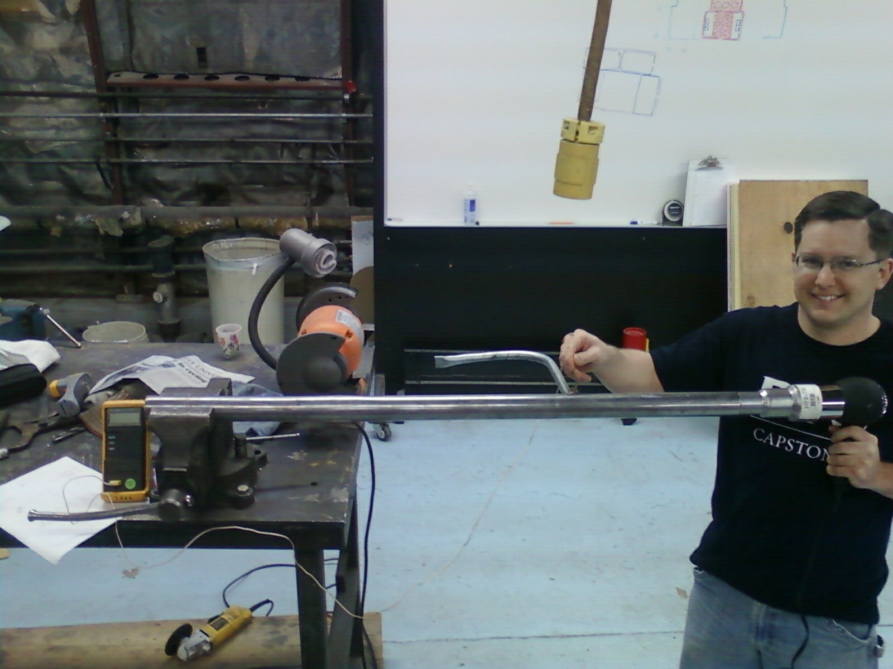
Test Setup
Sensor Pipe
Thermocouple
Exhaust Pipe
Heat Gun

Slide 5
Calculations and Results
Constants |  |  | Exhaust Pipe Properties |  |  | Exhaust Pipe Inside Air |  |  | Sensor Pipe Properties
Tinf [K] | 292.00 |  | T0 | 342.47 |  | TmLe_guess [K] | 373.57 |  | TLs_guess [K] | 294.33
g [m/s^2] | 9.82 |  | Dei [in] | 1.631 |  | Tbar_e [K] | 373.22 |  | Dsi [in] | 0.62
 |  |  | Deo [in] | 1.75 |  | nu_ei [m^2/s] | 2.35E-05 |  | Dso [in] | 0.72
Input Data |  |  | Le [in] | 11.8125 |  | cp_ei [J/(kg-K)] | 1011 |  | Ls [in] | 7.375
Tinf [C] | 19.00 |  | Dei [m] | 0.0414 |  | k_ei [W/(m-K)] | 3.18E-02 |  | Dsi [m] | 0.015748
T0 [C] | 69.47 |  | Deo [m] | 0.0445 |  | Pr_ei | 0.695 |  | Dso [m] | 0.018288
TLe_guess [C] | 65.77 |  | rei [m] | 0.0207 |  | Re_ei | 25526 |  | rsi [m] | 0.007874
TmLe_guess [C] | 100.57 |  | reo [m] | 0.0222 |  | x_fdhe [m] | 0.41 |  | rso [m] | 0.009144
Tmie [C] | 99.87 |  | Le [m] | 0.3000 |  | x_fdte [m] | 0.41 |  | ks [W/(m-K)] | 25
TLs_guess [C] | 21.33 |  | ke [W/(m-K)] | 25 |  | f | 0.02459455 |  | m [m^-2] | 18.3520
ue [ft/min/10] | 284.67 |  |  |  |  | Nuei | 61.7713 |  | Ls [m] | 0.187325
 |  |  |  |  |  | C_nozzle | 2.4254 |  |  |  |  | Key
 |  |  | Exhaust Pipe Outside Air |  |  | m_nozzle | 0.676 |  | Sensor Pipe Outside Air |  |  |  | Film Temperature
 |  |  | TLe_guess [K] | 338.77 |  | Nuei_bar | 101.0616 |  | Tfs [K] | 304.28
 |  |  | Tfe [K] | 316.31 |  | hei [W/(m^2-K)] | 77.58 |  | beta_s [K^-1] | 3.29E-03 |  |  | Convection Coefficient
 |  |  | beta_e [K^-1] | 3.16E-03 |  |  |  |  | nu_s [m^2/s] | 1.63E-05
 |  |  | nu_e [m^2/s] | 1.75E-05 |  | Exhaust Pipe Temperature Profile |  |  | Pr_s | 0.706 |  |  | Calculated Temperature
 |  |  | Pr_e | 0.705 |  | Tmie [K] | 372.87 |  | kinf_s [W/(m-K)] | 2.66E-02
 |  |  | kinf_e [W/(m-K)] | 2.75E-02 |  | Pe [Pa] | 88000 |  | cp_s [J/(kg-K)] | 1007
 |  |  | cp_e [J/(kg-K)] | 1008 |  | R_air [J/(kg-K)] | 286.5
 |  |  |  |  |  | U_bare | 9.4838
 |  |  | Exhaust Pipe Convection/Radiation |  |  | rhoe [kg/m^3] | 0.8238 |  | Sensor Pipe Convection/Radiation
 |  |  | Gre | 431157 |  | ue [m/s] | 14.4611 |  | Grs | 18214
 |  |  | Rae | 303966 |  | mdote [kg/s] | 0.0161 |  | Ras | 12859
 |  |  | Nue | 10.4521 |  | TmLe [K] | 371.04 |  | Nus | 4.6414
 |  |  | heo_bar [W/(m^2-K)] | 6.4664 |  |  |  |  | hso_bar [W/(m^2-K)] | 6.7509
 |  |  | sigma | 5.67E-08 |  | Exhaust Pipe External Temperature |  |  | sigma | 5.67E-08
 |  |  | epsilon_e | 0.5 |  | Rconv_ie [K/W] | 0.3301 |  | epsilon_s | 0.5
 |  |  | hr_avge [W/(m^2-K)] | 3.6100 |  | Rconde [K/W] | 0.0015 |  | hr_avgs [W/(m^2-K)] | 3.1998
 |  |  | heo [W/(m^2-K)] | 10.08 |  | Rconv_oe [K/W] | 2.3686 |  | hso [W/(m^2-K)] | 9.95
 |  |  |  |  |  | qe [W] | 29.2724
 |  |  |  |  |  | TLe [K] | 361.34 |  | TLs [K] | 296.45
Excel sheet used to perform calculations.
Summary
Test 1 | Measured | Predicted | % Error
TmLe [C] | 100.78 | 105.65 | 4.62%
TLe [C] | 41.97 | 97.09 | 56.77%
TLs [C] | 27.70 | 28.92 | 4.22%
Test 2
TmLe [C] | 100.57 | 98.04 | -2.57%
TLe [C] | 65.77 | 88.34 | 25.55%
TLs [C] | 21.33 | 23.45 | 9.01%
Measured vs. calculated values with percent error. Note the good accuracy of the final calculation (TLs) despite considerable error in intermediate calculation (TLe).
Predicted plot of sensor pipe temperature vs. length with measured values shown. Bars on measured results represent 95% confidence.

Slide 6
Discussion of Results and Conclusions
Challenges
Test conditions not controlled as well as hoped. Assumed quiescent air, had forced convection at times.
Largest error likely from predicting T_{Le}
Thermal circuit models whole length of pipe instead of just end
Cold forced convection in test area caused lower temp readings
Instrument error, infrared vs. thermocouple
Conclusions
Heat transfer is Fun!
With appropriate assumptions and simplifications modeling method can still be fairly accurate
Use a metal with low conductance so the heat transfer is less through the sensor pipe
Weld size and type can act as heat sink
Imagine the size of the weld bead before we ground it.

