Slide 1
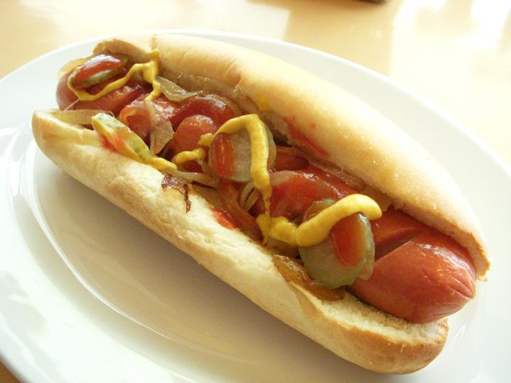
Hot dogs, HOT Dogs, and more hot dogs…
Me 340: Heat Transfer
Spencer Madsen
Dan Shelley

Slide 2
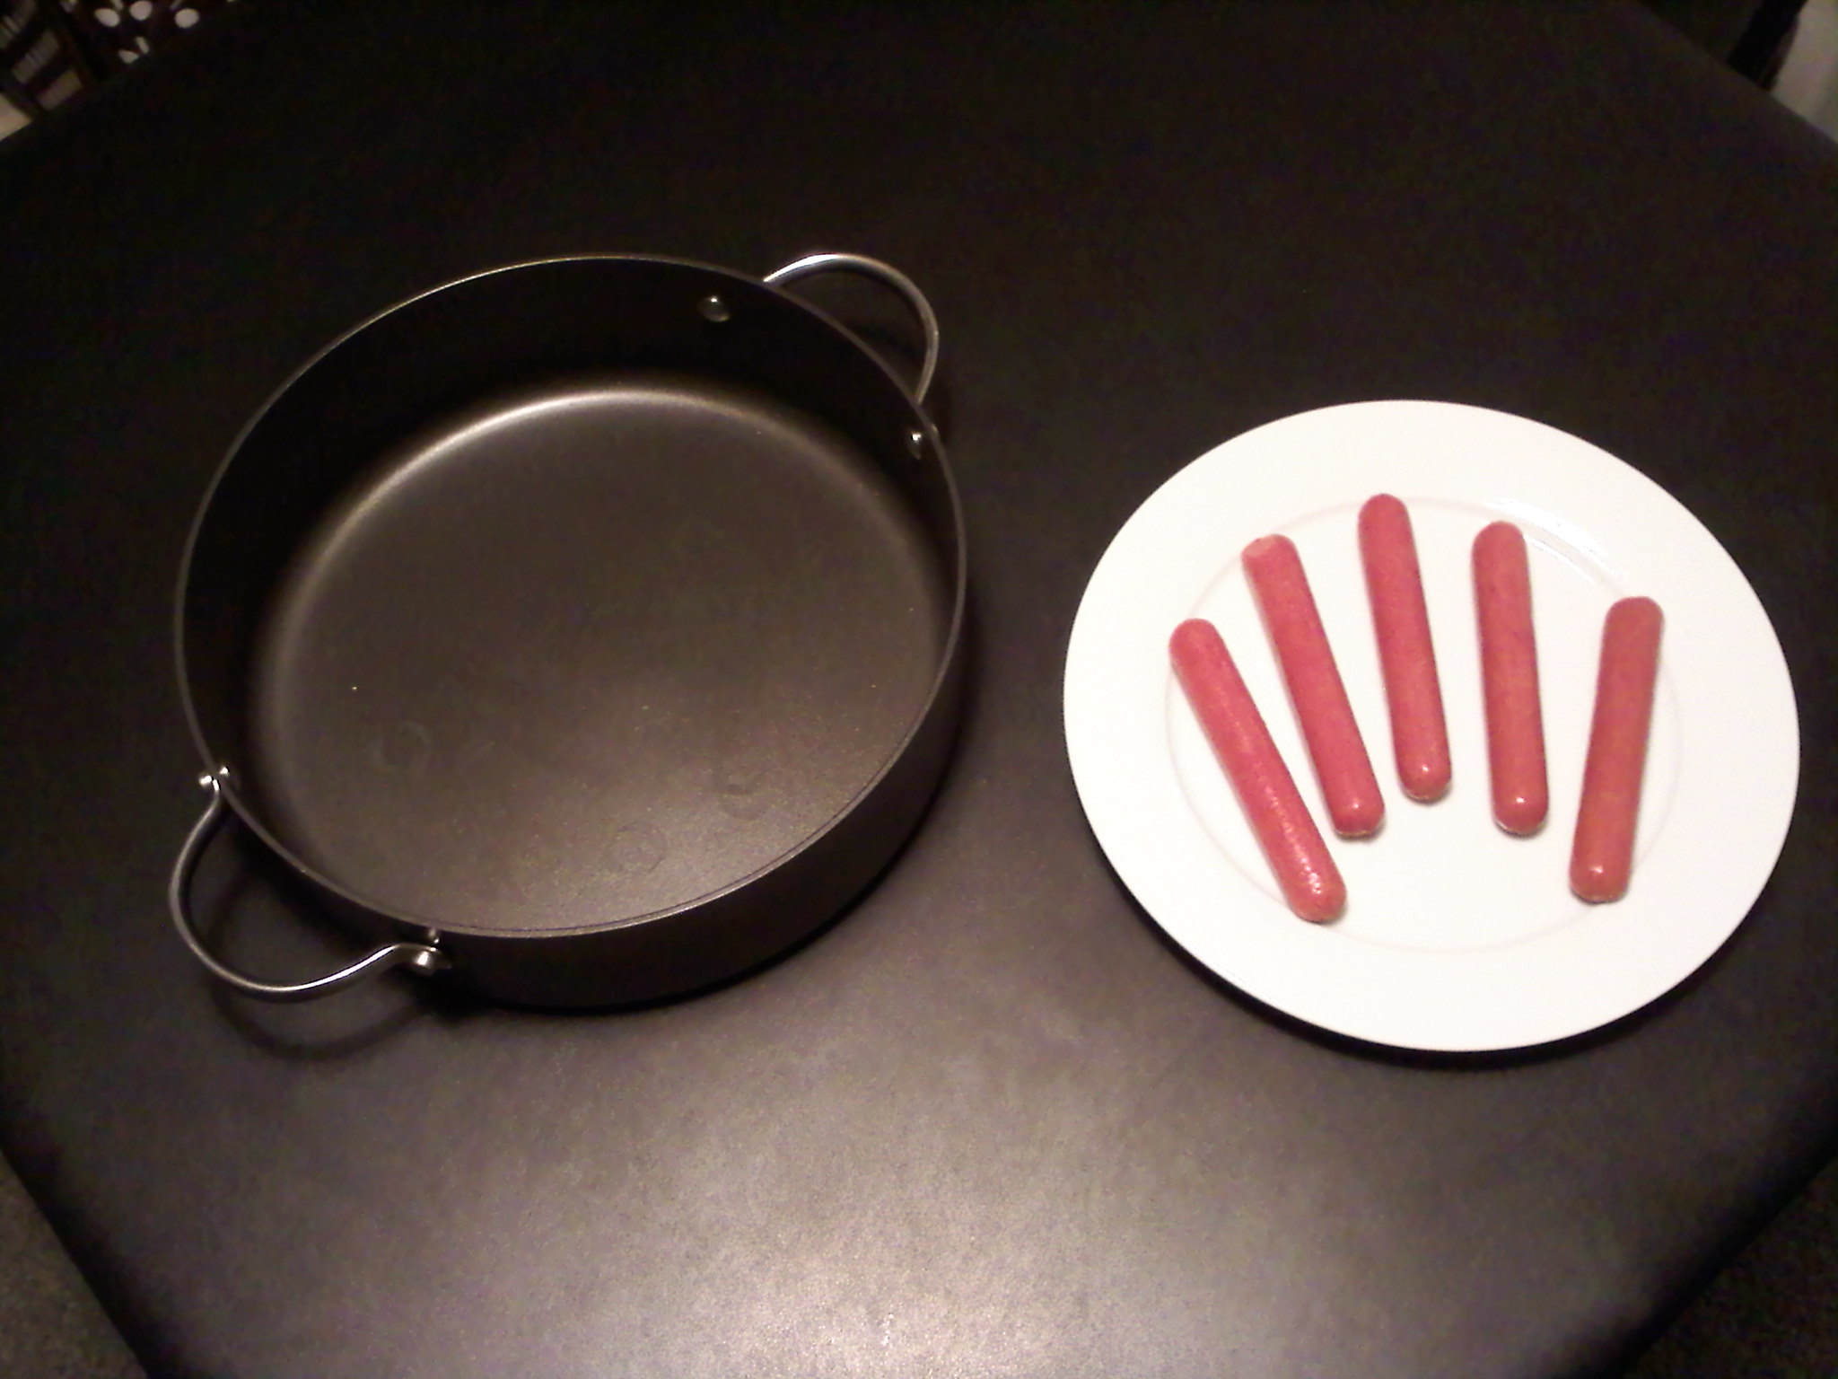
Time To Cook a Hot Dog
Me 340: Heat Transfer
Spencer Madsen
Dan Shelley

Slide 3
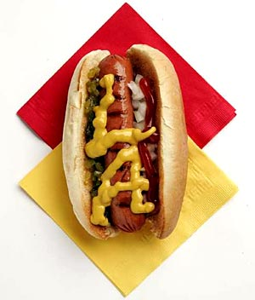
The Problem
We love hot dogs!
We wanted to know how long it would take to cook a hot dog to a certain temperature
Through experimental results we chose 80° C for the desired inside temperature.
The goal was to create a mathematical model that could be validated by empirical results.

Slide 4
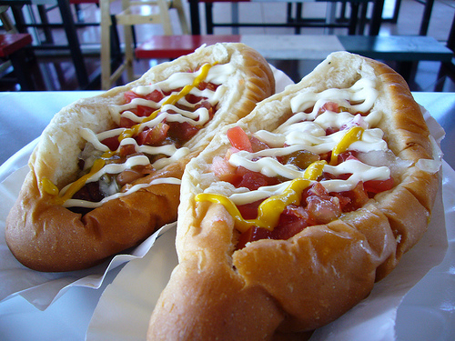
Our Assumptions
Temperature of the boiling water was 100° C
The hot dog can be analyzed as an infinite cylinder
The hot dog has constant properties
The hot dog’s properties are:
k = .52 W/m-K
ρ = 880 kg/m³
c_{p} = 3350 J/kg-K
h = 100 W/m²-K
r₀ = 10 mm or .01 m
T_{i} = 6° C
T∞ = 100° C
T_{f} = 80° C

Slide 5
The Experiment
First:
We cooked a hot dog in boiling water until it was done. Once done we measured the inside temperature with a thermometer. T_{f} = 80° C
Second:
We performed the analysis to calculate the time.
Third:
We performed the experiment again, measured the time, and measured the outside temperature.

Slide 6
The Analysis
First:
Found the Biot Number
Bi = hL_{c}/k = hr₀/2k = (100 W/m²-K *(.01 m))/(2*(.52) W/m-K)
Bi = .96
Since Bi > .1 Analysis with lumped capacitance is inappropriate.
Second:
Therefore, we used the Heisler Chart
Bi = hr₀/k = (100 W/m²-K *(.01 m))/(.52 W/m-K)
Bi = 1.92
Found Θ₀* = Θ₀/Θ_{i} = (T_{f}-T∞)/(T_{i}-T∞)
Θ₀* = (80-100)/(6-100) = .21

Slide 7
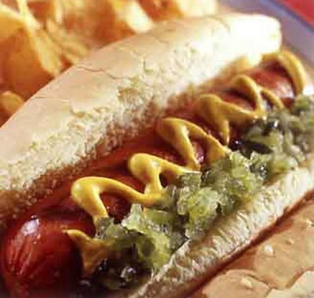
The Analysis
Third:
Found Fo = t* where t* = αt/r₀² Therefore, Fo = .8
Also α = k/(ρc_{p}) = (.52 W/m-K)/((880 kg/m³)*(3350 J/kg-K))
α = 1.764E-7 m²/s
Finally:
So t = (r₀²Fo)/α = ((.01 m)²(.8))/(1.764E-7 m²/s)
t = 453.5 seconds or 7.6 minutes

Slide 8
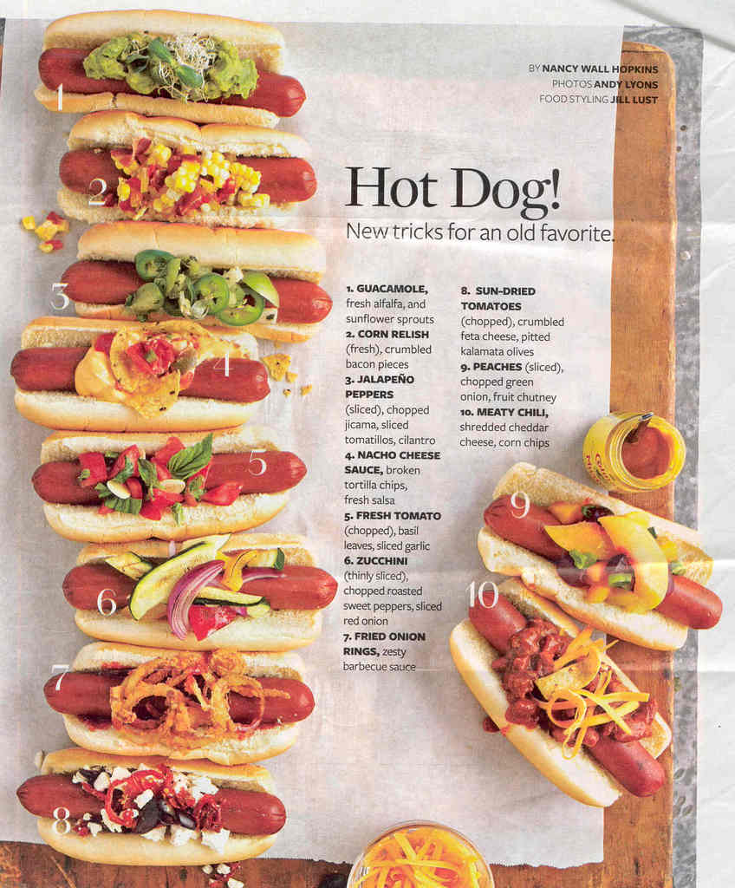
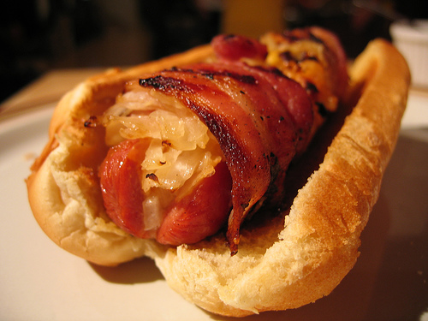
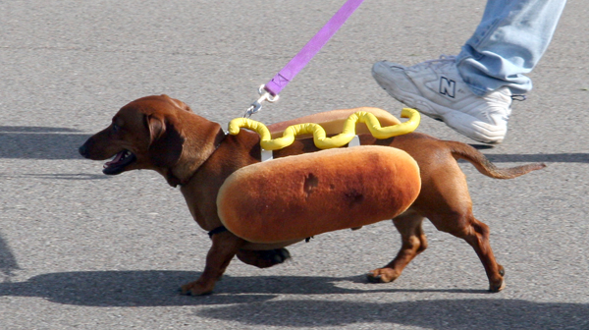
Conclusion
Analytical
Experimental
Time calculated to cook a hot dog to 80° C was 7.6 minutes
Time to actually cook a hot dog to 80° C was 6.2 minutes

Slide 9
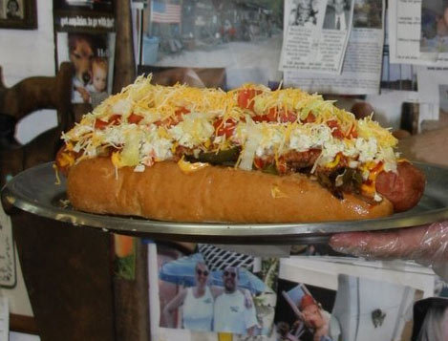
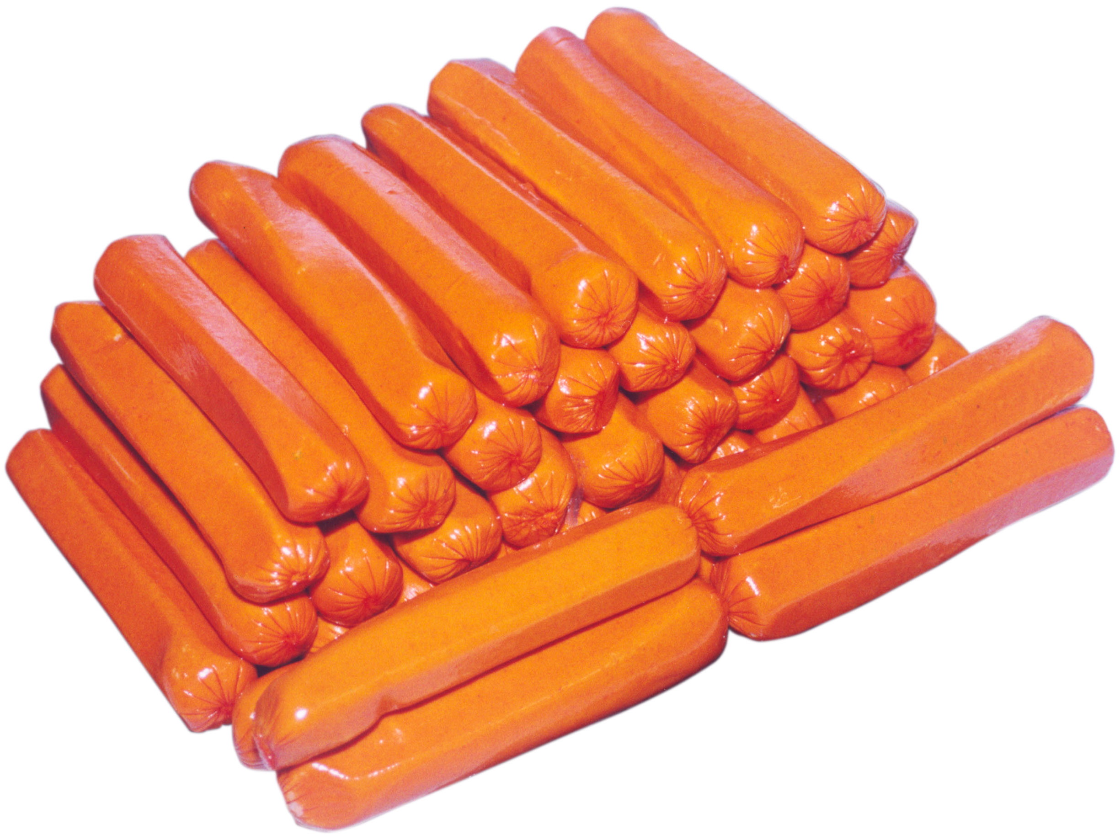
Discussion
Reasons why our analysis and experimental results differed:
Thermometer’s time constant and inaccuracy
Boiling temperature differs with altitude
Each hot dog differs slightly in properties
Human error in the experimental design

