Slide 1
Convective Coefficients for Various Lid Materials
Austin Richardson
Preston Hennrich

Slide 2
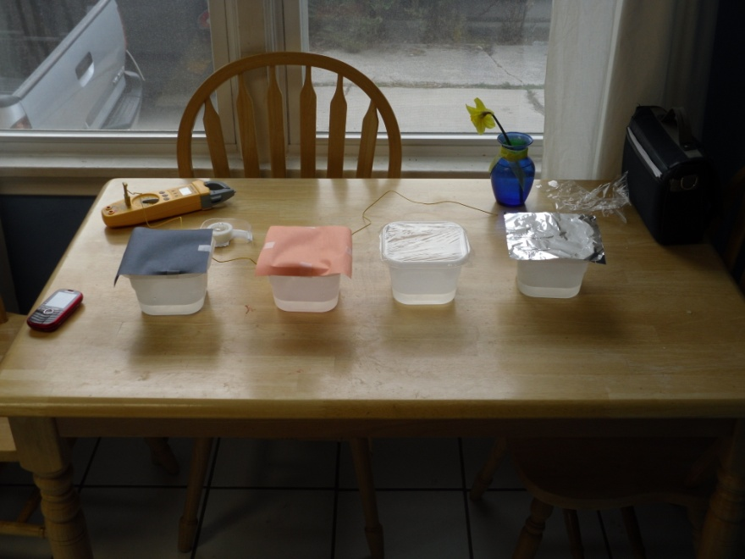
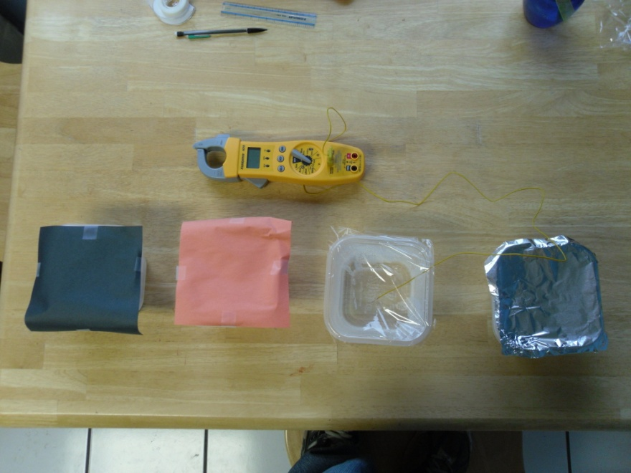
The Project
Our goal was to discover whether having different lid materials would affect the rate of heat transfer from hot water in a bowl
The different colors give a difference in the amount of radiation given off by each lid

Slide 3
Data

Slide 4
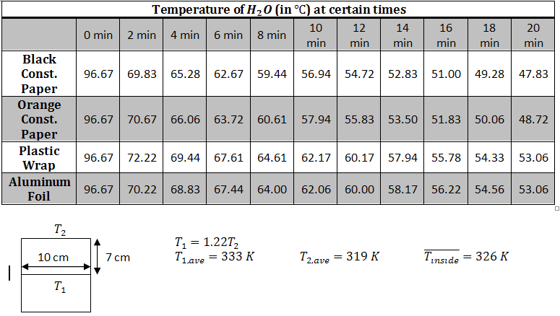
Calculations
 | Black Paper | Orange Paper | Plastic Wrap | Aluminum Foil
Emissivity | 0.9 | 0.74 | 0.9 | 0.05

Slide 5
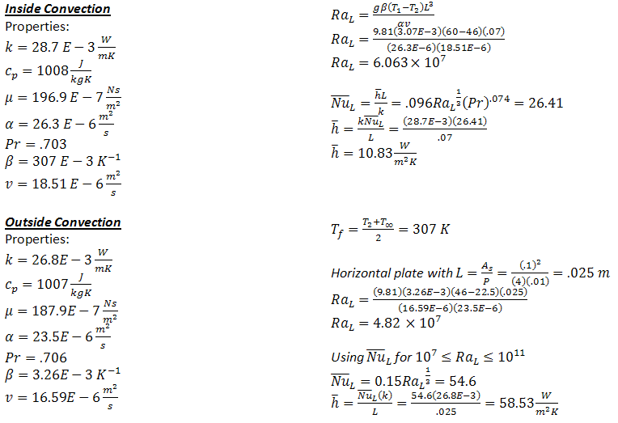
Calculations Cont.

Slide 6
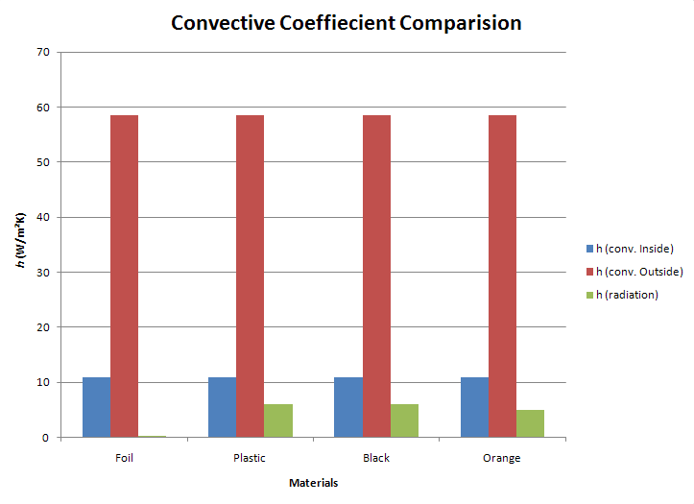
Summary

Slide 7
Conclusion
The largest method of heat transfer is due to convection on the external surface (due to high h value)
Though heat was transferred through the sides and bottom of the containers, it was assumed constant for each and could then be neglected in order to look at the desired aspects of the experiment (effect of lid type)
h of radiation << h due to convection
For certain materials, h due to radiation might need to be considered, while for others it can be neglected (as seen on the bar graph)
In this case the different conduction coefficients (k) for each material also play a role in the amount of heat transferred, as can be seen by comparing the plastic and foil temperature paths
Conclusion: Shiny, plastic lids would work the best!!

