Slide 1
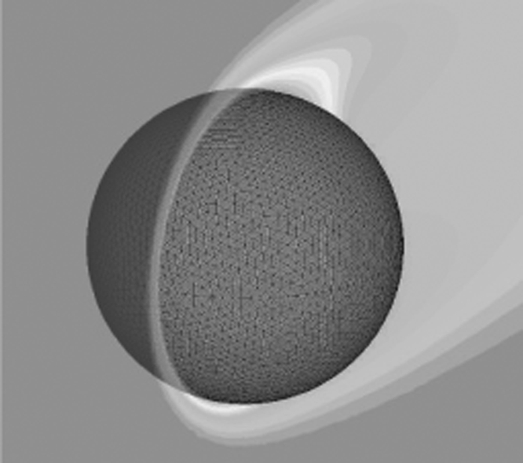
ME 340 Final Project
The effect of the Forced Convection vs the Free Convection
Fengqi He
Nanzhu Zhao
Winter/2010

Slide 2
Introduction
It has been a common sense that when something is too hot to touch, we usually blow on it to cool it down faster.
But Why do we actually do that?
Does that really help a lot to cool things down faster?
And How much does that affect the cooling speed?
Therefore, this project is to emphasize the significance of the forced convection versus the free convection.

Slide 3
Introduction
Objective:
Analyze the effect of the Forced convection to see the importance of the forced convection versus the free convection.
Use a cylindrical aluminum bar to measure the time needed to cool it down to the room temperature with/without a fan.

Slide 4
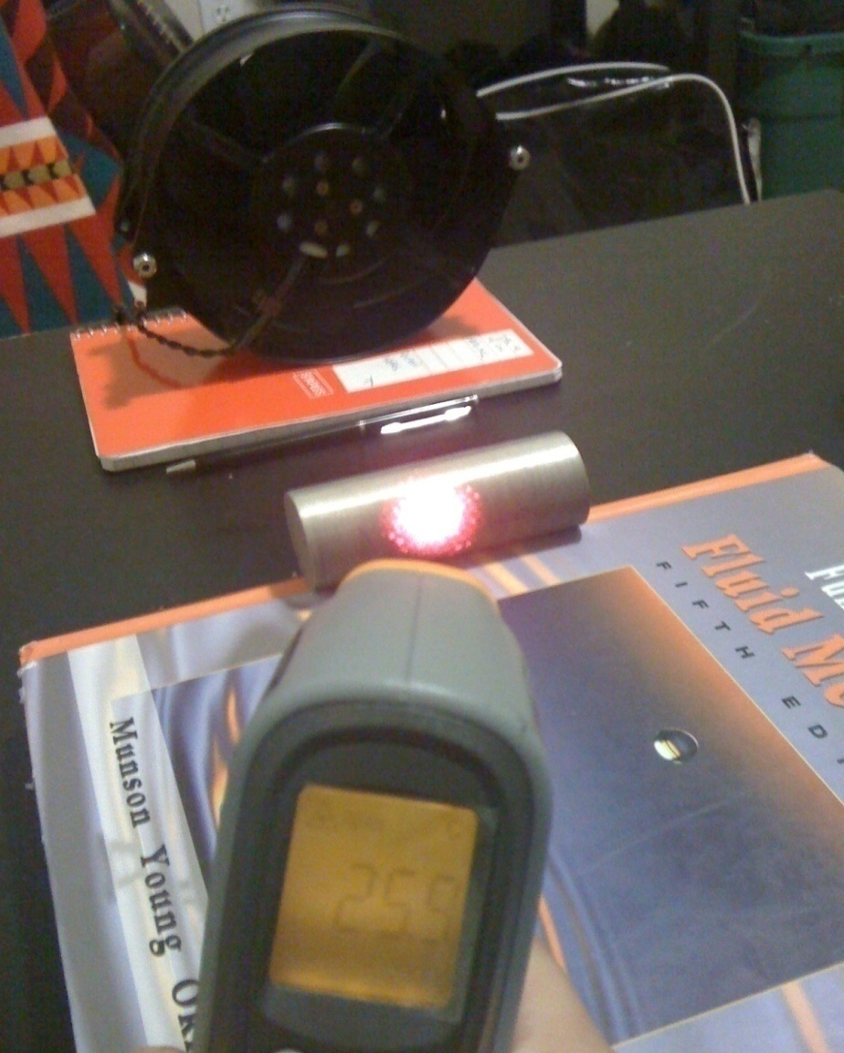
Problem Setup
Preheat the aluminum bar to Ts = 40⁰
Use a fan to generate horizontal forced convection.
Measure the room Temperature Troom = 23⁰.
Measure the time needed to go down to T = 25⁰.
Repeat the procedure above without the fan.

Slide 5
Predicted Solution
According to our calculation using series of equations provided in Appendix, we got the predicted time needed would be:
Time 1 ≈ 10 min with a fan.
Time 2 ≈ 50 min without a fan.

Slide 6
Measured Results
Time needed with fan:
T= 9 min 6 sec.
Time needed without fan:
T= 45 mins.

Slide 7
Error Analysis
We found that the measured time is less than the predicted result because there could some other way of heat loss such as radiation and the conduction.

Slide 8
Conclusion
From the time difference between these two experimental results, we can definitely be sure that
Forced Convection >> Free Convection
And that is why we use forced convection as the major cooling method in electrical devices such as the CPU in computer.

Slide 9
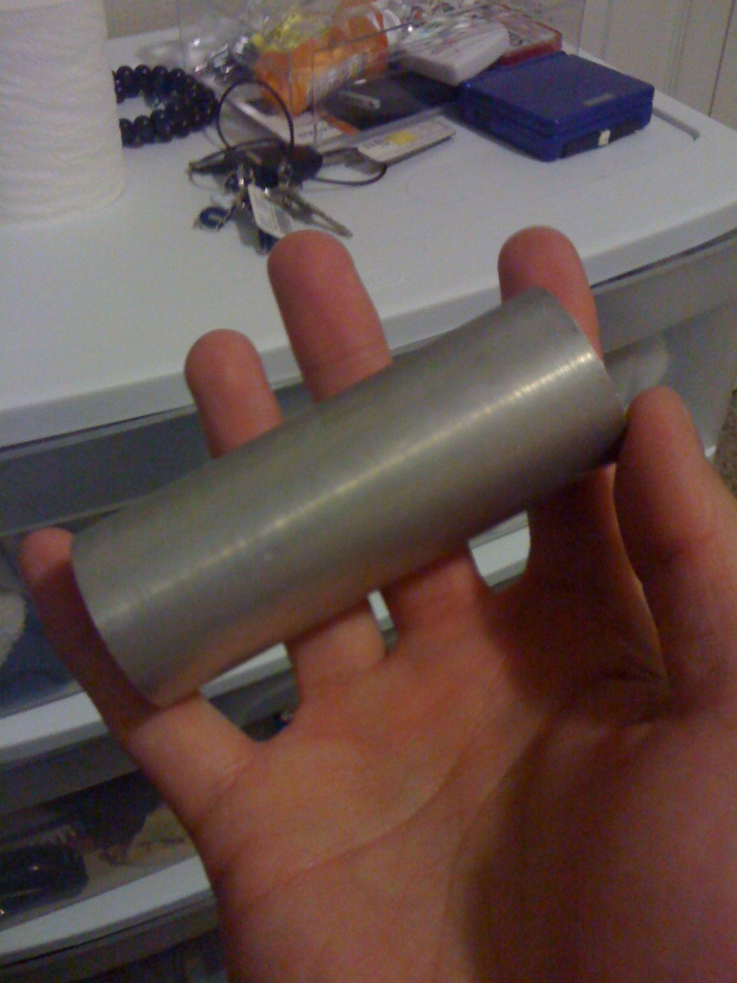
Appendix
Measured properties:
L = 8.5 cm;
D = 3.2 cm;
Tsurface = 40 ⁰
T∞ = 23 ⁰
Tfinal = 35 ⁰
Vfan = 10 m/s

Slide 10
Appendix
Use Properties of the air at T = 300 K.
General equations applied:

Slide 11
Appendix
Calculated values:
hforced = 64.6 W/(K*m^2).
hfree = 5.4 W/(K*m^2).
htotal ≈ 64.4 W/(K*m^2).

Slide 12
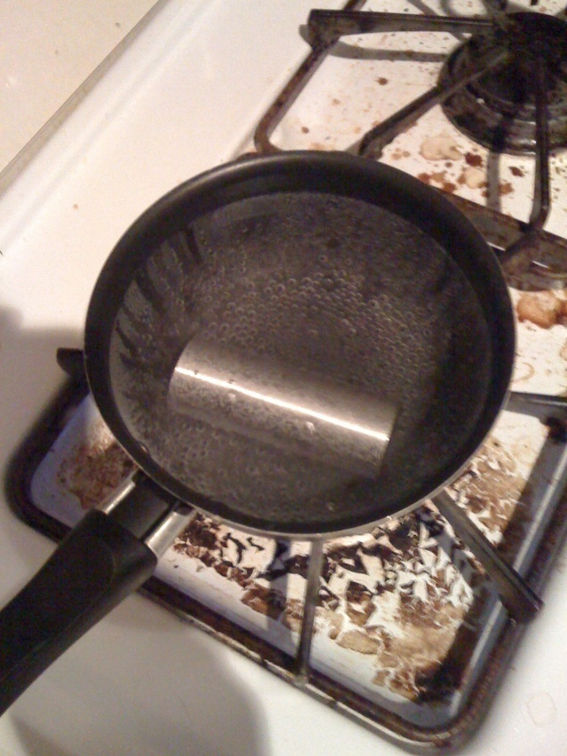
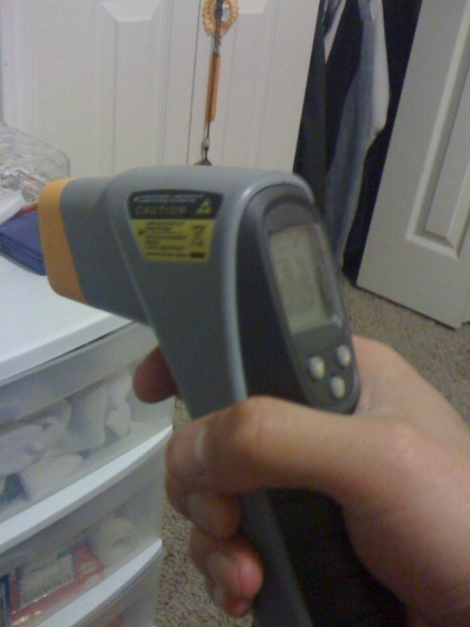
Appendix
Pictures of procedure:

