Slide 1
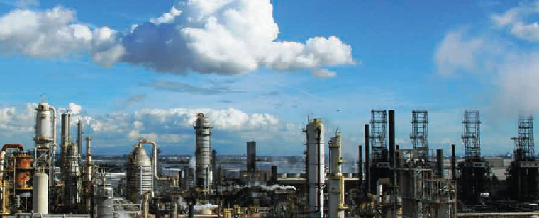
Insulation Thickness Calculator
Me 340 Project
Ben Richards, Michael Plooster

Slide 2
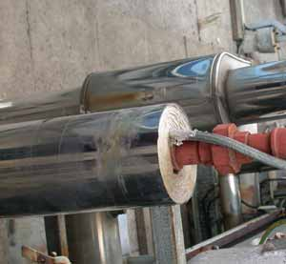
Project description
-In many applications it is desirable to insulate a pipe in order to protect those working near it.
-It would be convenient to have a program that could calculate the required insulation thickness based on fluid properties and desired temperatures (usually already known).
-Project Objective: Create an Excel worksheet that can calculate the insulation thickness for a variety of fluid, pipe, and insulation types.
Photo courtesy of resources.schoolscience.co.uk/.../4/pipes.html

Slide 3
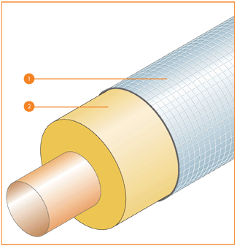
Heat Transfer Principles
-Convection from the fluid to the pipe.
-Assume constant surface temperature.
-Conduction through the pipe.
-Conduction through the insulation.
-Radiation considered negligible.
-Insulation surface is usually very reflective.
-Use Thermal Resistance to calculate the required thickness.
Known Values:
Calculate:
Q = Volume flow rate
T_{m,i} = Inlet fluid temperature
T_{m,o} = Outlet fluid temperature
T_{s} = Desired surface temperature
Fluid Properties
ρ = density
c_{p} = specific heat
k = thermal conductivity
μ = Dynamic viscosity
Pr = Prandtl number
Pipe Properties
D₁ = Inner Diameter
D₂ = Outer Diameter
k = Thermal conductivity
L = total pipe length
Insulation Properties
k = Thermal conductivity
q = convective heat transfer from fluid
R_{fluid} = Thermal Resistance of fluid
f = friction factor for the pipe (assuming smooth)
Re = Reynolds number to determine laminar or turbulent flow.
Nu = Nusselt Number
h = Convective coefficient for the fluid
R_{pipe} = Thermal Resistance of pipe
R_{insul} = Thermal Resistance of the insulation
R_{tot} = Total Thermal Resistance

Slide 4
Solution
q = ρ*Q*c_{p}*(T_{m,i} - T_{m,o})
R_{tot} = ΔT/q = [((T_{o} + T_{i})/2) – T_{s}]/q
R_{tot} = R_{fluid} + R_{pipe} + R_{insul}
R_{insul} = R_{tot} - R_{fluid} - R_{pipe}
Re_{D} = 4*ρ*Q/(π*D*μ)
If laminar, Nu = 3.66
If Turbulent, Nu = [(f/8)*(Re_{D} - 1000)*Pr]/[1 + 12.7*(f/8)^{1/2}*(Pr^{2/3} -1 )]
For a smooth pipe, f = (0.790*ln(Re_{D}) - 1.64)⁻²
h = k_{fluid}*Nu/D₁
R_{fluid} = 1/[h*L*π*D₁]
R_{pipe} = ln(D₂/D₁)/(2*L*π*k_{pipe})
R_{insul} = ln(D₃/D₂)/(2*L*π*k_{insul}),
D₃ = D₂*exp(R_{insul}*2*L*π*k_{insul})
t = (D₃ - D₂)/2
←Final Solution

Slide 5
Program Results
Main Features:
-Drop Down Boxes for Convenience
-Material tables can easily be edited to fulfill the company’s specific requirements.
-Includes equations and results in order to verify solutions.
340Project.xlsx

Slide 6
Conclusion
-Works well as a general tool.
-Needs more specific data to improve usefulness.
-Only accurate as long as the assumptions are true.
-Sometimes no insulation is required, which the program indicates.
-Simplifies the engineering process.
-Would be nice if it had a cost estimate calculator.

Slide 7
Appendix
Property values used in the Pipe Insulation Calculator were obtained from Tables A.1 and A.3 of Fundamentals of Heat and Mass Transfer(Sixth Edition) by Incropera, DeWitt, Bergman, and Lavine.
Equations were also obtained from Fundamentals of Heat and Mass Transfer (Sixth Edition) by Incropera, DeWitt, Bergman, and Lavine.

