Slide 1
Heat Transfer for a Zirconium Billet
Devin Athey and Travis Rampton

Slide 2
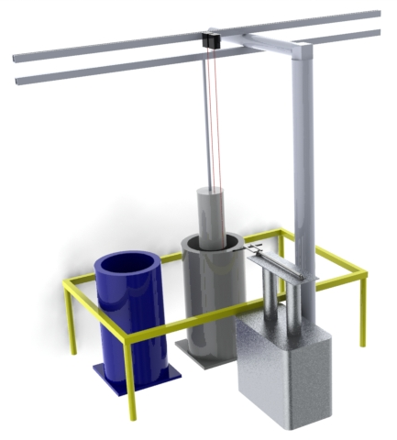
Overview
Modeled our Capstone project- time to heat a Zirconium Billet to 140-145 degrees farenheit
Used 1st Term Approximation
Compared to experimental measurements

Slide 3
Finding the Values
First we assumed an infinite cylinder, in order to neglect end effects.
Solved for the h value
h=405
Found the Biot number to be too high for lumped capacitance (lumped capacitance method gave t=35.75 seconds)
Used 1st term approximation to solve for time
Found t to be 84 seconds, with Fo=.442787

Slide 4
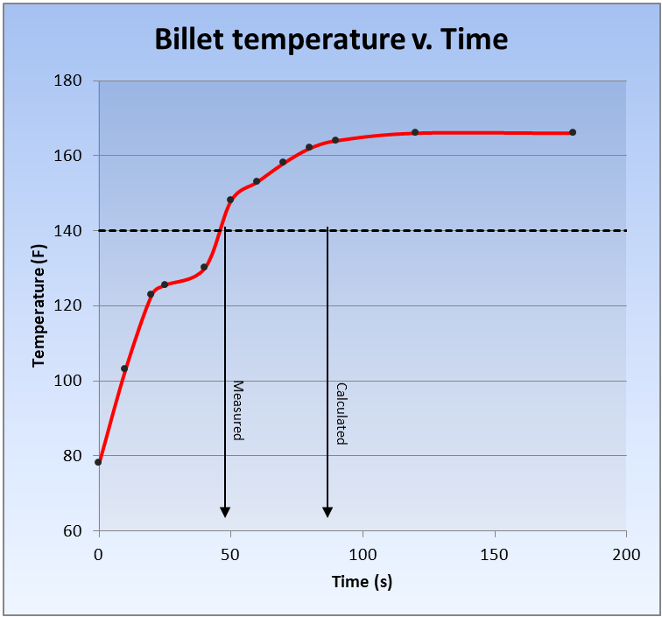
Results
Found time to heat to be 84 seconds
50 seconds was the measured experimental time
Accuracy was 68%

Slide 5
Conclusions
Compare these results with Concentric Cylinders values (another group project)
Determine end effects ( )
Examine changes in start temperature of billet (i.e. changes in seasonal temperatures- winter to summer)

