Slide 1
Boiling Water Calculator
Jacob Adams
ME 340 Winter 2010

Slide 2
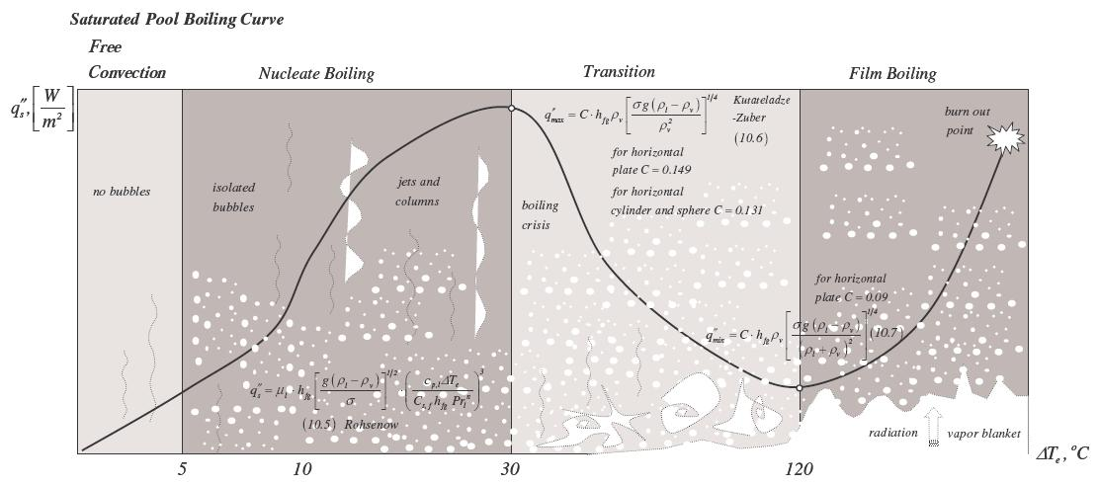
The Problem:
Long complex boiling equations
Numerous cases and different variations can be confusing
Evaluation takes a lot of time

Slide 3
The Solution:
A Calculator!
Makes calculations quick and easy
Helps eliminate calculation errors
Covers many different cases with minimal changes

Slide 4
The Calculator
Calculates:
Excess Temperature
Type of Boiling
Nucleate Heat Flux
Critical Heat Flux
Minimum Heat Flux
Calculates values using:
Rohsenow Correlation
Kutateladze-Zuber Correlation

Slide 5
Demonstration

Slide 6
Limitations
In order to keep user required variables at a reasonable level, film boiling heat flux cannot be determined by the calculator.
Values for critical and minimum heat fluxes can be inaccurate if excess temperature is not close to key values of 30 and 120 C.
Limited to boiling of water - calculator could be expanded to include other fluids and material interfaces.

Slide 7
Acknowledgements
Prof. Soloviev and his boiling equation sheet
Incropera and DeWitt’s Fundamentals of Heat and Mass Transfer

