Slide 1
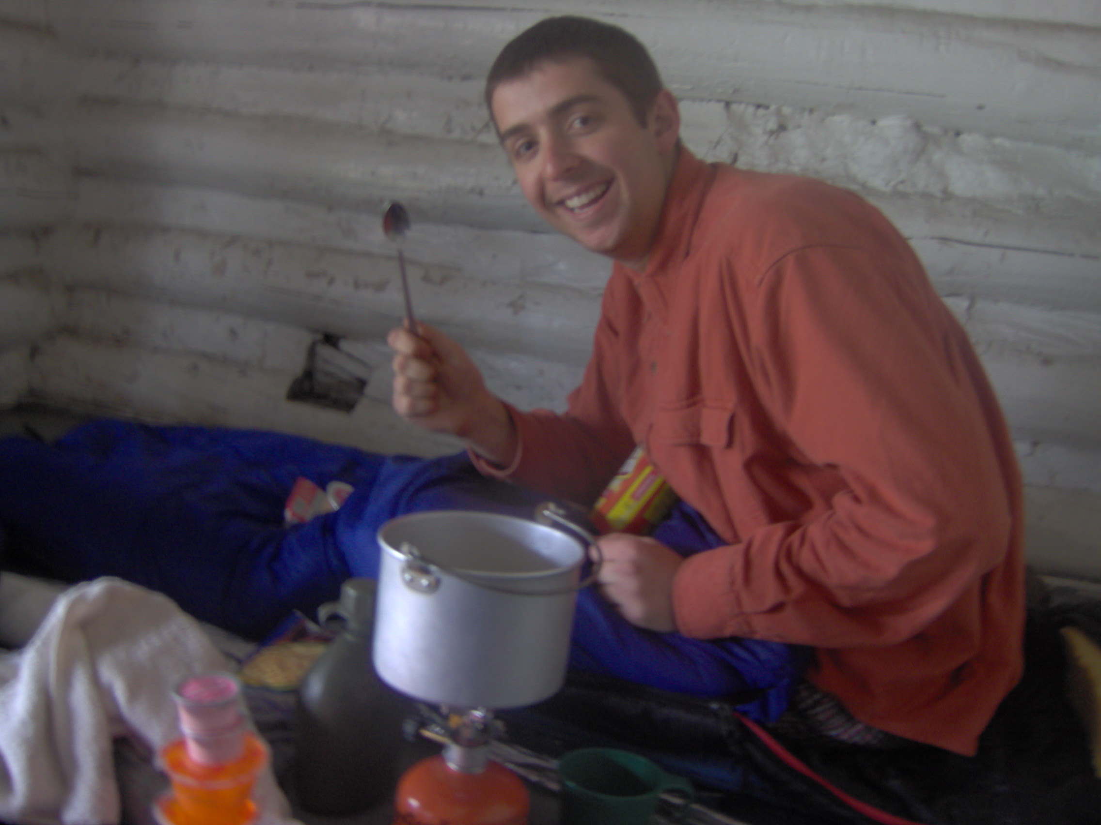
Designing a Better Camping Pot
Mark Fernelius
Luke Duffield

Slide 2
Overview
We wanted to design a backpacking pot that would decrease cooking times using fins on the bottom and sides. This would decrease the amount of fuel needed and, thus, the weight a backpacker would need to carry.

Slide 3
Our Design

Slide 4
Assumptions
Constant temperature on the bottom
Reasonable surface and air temperatures
Averaged properties over the process
Fins modeled as isothermal, parallel plates
Fuel burning temperature
Radiation is approximately equal between the two cases, so it was neglected
Convection coefficient approximately equal between the two cases

Slide 5
Results
 | Resistance | q
Without fins on bottom | 2.8 K/W | 32 Watts
With fins on bottom | 0.316 K/W | 289 Watts
Fins on Side | 58 K/W | .22 watts
Fins on the side contribute very little. It would be best to not include them as the added weight is not offset by higher performance.
Fins on the bottom increase heat flux by a factor of nine, so they are worth the added weight.

