Slide 1
Oh the Places You’ll Go!
ME 340 Final Project
Daniel Tanner
Joseph Paredes

Slide 2
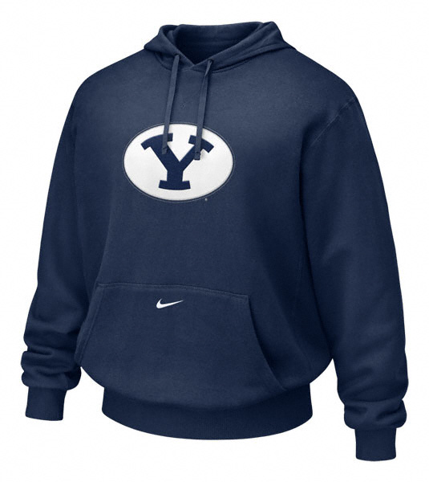
Objective
What will your torso skin temperature be at a BYU Football game if you decide to wear your cotton BYU sweater for certain weather conditions?

Slide 3
Assumptions
Neglect radiation and T-shirt on torso
Assume internal core body temperature is constant throughout torso (98.6 F)
Assume air is in cross flow
Assume the human torso can be modeled by an isothermal cylinder
Assume skin properties are constant
Wind can’t penetrate jacket
Ambient temperature is 50 F

Slide 4
Schematic and equations

Slide 5
Spreadsheet
Constants r1 (m) 0.121 r2(m) 1.24E-01 r3(m) 1.34E-01 kskin (W/mK) 0.37 kcotton(W/mK) 0.06 height of torso (m) 0.8 Tcore (K) 310.15 98.6 F Tair (K) 283.15 50 F Thickness of jacket (m) 1.00E-02 0.004 Thikness of Skin (m) 3.00E-03

Slide 6
Graph of jacket protection with wind

Slide 7
No Wind. Calm day at BYU football game
With sweater: 97.34 F
Without sweater: 97.04 F
Temperature Difference: 0.3F

Slide 8
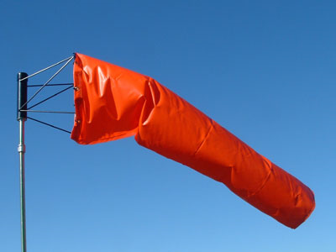
With WIND: MILD WIND AT FOOTBALL GAME
With sweater: 95.64 F
Without sweater: 92.96 F
Temperature Difference: 2.684702 F

Slide 9
WITH WIND: Skydiving into BYU Stadium
With sweater: 93.83 F
Without sweater: 76.95 F
Temperature Difference: 16.87 F

Slide 10
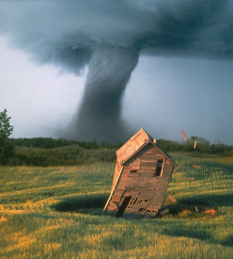
With WIND: Stuck in BYU Stadium in a tornado
With sweater: 93.50 F
Without sweater: 67.62 F
Temperature Difference: 25.88 F

Slide 11
Conclusion
Wear a sweater at a BYU game when under a tornado or sky diving into the stadium. If not you will feel really cold. (>15 F difference)
Wearing the sweater is optional on a calm day or at mild wind. (Its personal preference. Not much temperature difference.)

Slide 12
The End

