Slide 1
Analysis of a Lightsaber
Ryan Faber and Devan Anderson

Slide 2
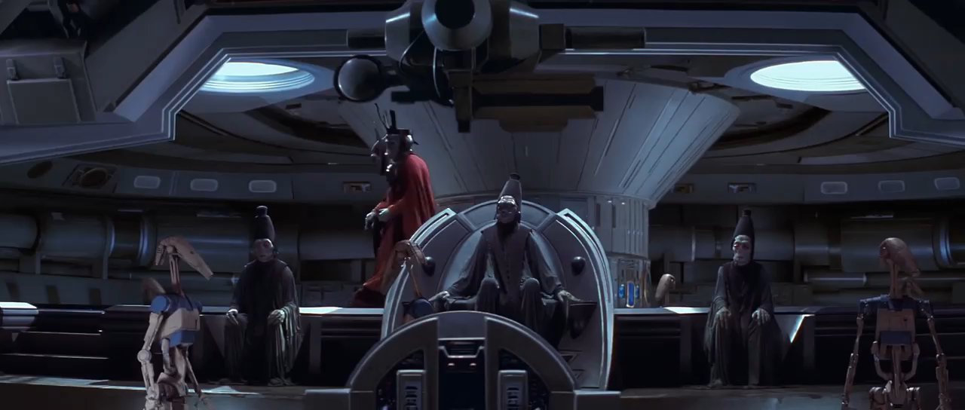
The Premise

Slide 3
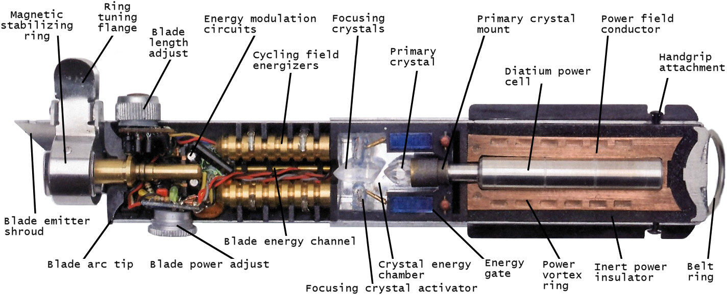
Purpose and Methodology
To calculate the flux and surface temperature of a lightsaber
Use the above video clip as a premise for a heat transfer analysis
Apply basic principles of thermodynamics and radiative heat transfer to calculate the desired properties of a lightsaber

Slide 4
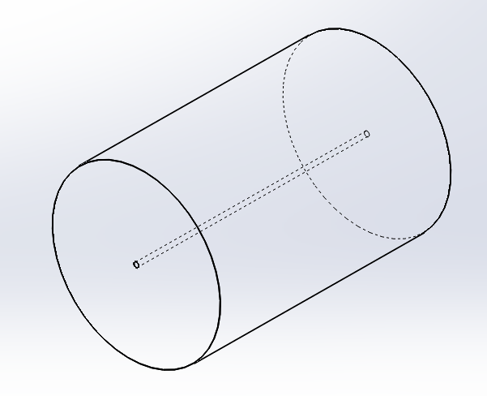
Assumptions
Blast Gates modeled as iron
  Cp: 0.45 kJ/kg*˚C
  Latent heat of fusion: 272 kJ/kg
  Melting point: 1500 ˚C
  Density: 8000 kg/m^3
  Absorptivity: 0.9
Assumed that volume of iron melted was a cylinder of 1.5 m long with a diameter of 1 m over the course of 10 seconds
Assumed that no heat was transferred outside melted cylinder
Assumed that lightsaber is a cylinder with length of 1.5 m and diameter of 0.03 m
Assumed that heat transfer was purely by black body radiation over a 10 second period

Slide 5


Calculations
$V=0.375π$ m^3
$$M=9425 kg$$
SA= 0.212 m^2
Energy Required (E) =
$$Cp∗M∗∆T+M∗Latent heat$$
= 8.84*10^6 kJ
$$\text{Q}\text{”= }\text{E}\text{/(}\text{t}∗\text{SA}\text{)}$$
=4.17*10^6 kW/m^2
Radiation Absorbed
$$Q"= ∝∗σ∗Ts^4$$
Ts = 3008 K

Slide 6
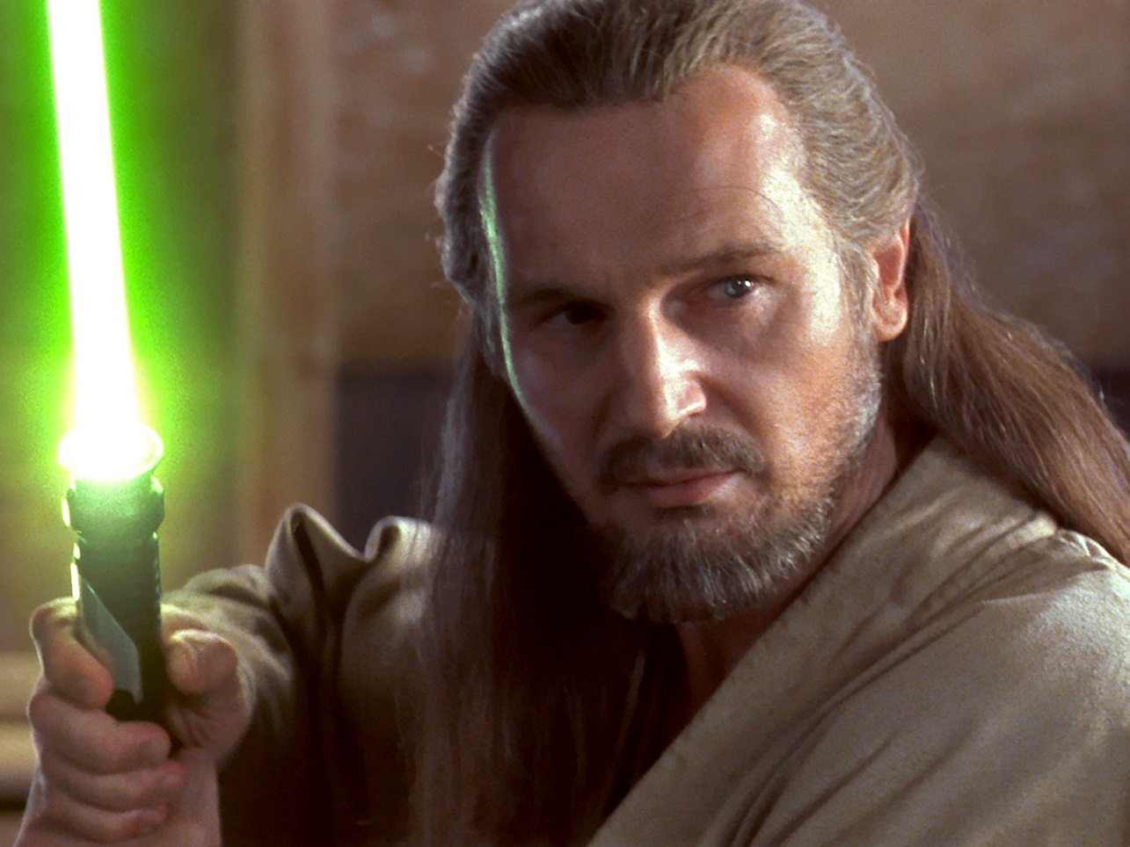
Results and Conclusion
Q”=4.17*10^6 kW/m^2
Ts = 3008 K
Our conclusion from this analysis
Don’t mess with Qui Gon Jinn or for that matter anyone wielding a lightsaber

