Slide 1
ME EN 340 Final Project BYU 2014
Thermophysical Property Explorer
Daniel McArthur

Slide 2
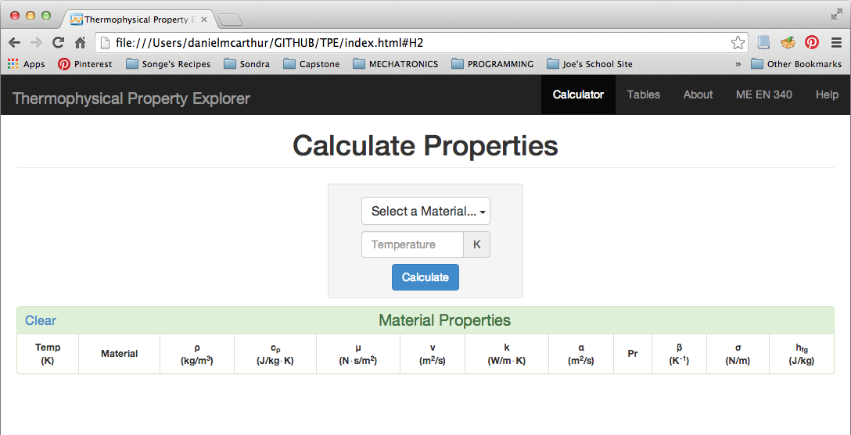
Project Description
Designed and programmed an application that calculates thermophysical property values and incorporates graphs and charts to help visualize the information.

Slide 3
Motivation
Want a way to visualize how the material properties change with temperature, and visualize the differences between different materials
Want to be able to calculate properties for several materials & temperatures and see them all simultaneously
Want values given in standard SI units to prevent computational errors
(e.g. Display c_{p}= 1.25e3 J/kg•K instead of c_{p}= 1.25 kJ/kg•K)
Want a property calculator that can be accessed online rather than requiring a download
If a download is preferred (for offline access), want a cross-platform solution to work on any OS

Slide 4
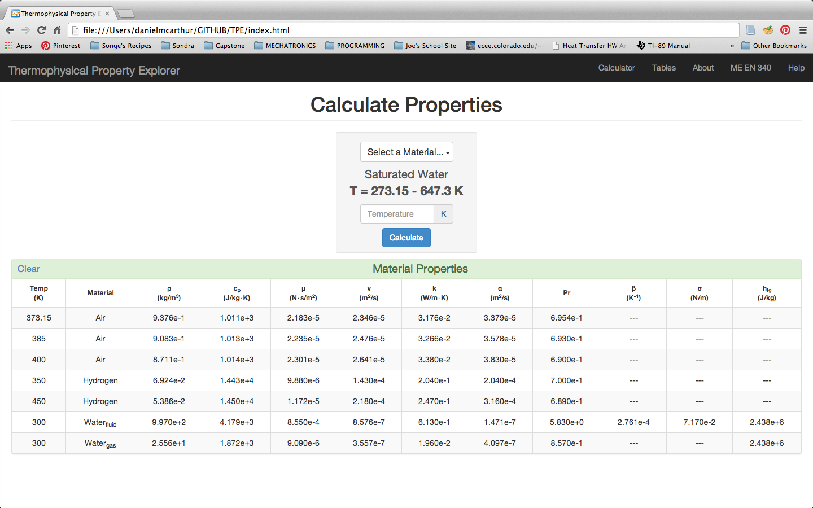
Key Features
Table format displays multiple calculated properties simultaneously

Slide 5
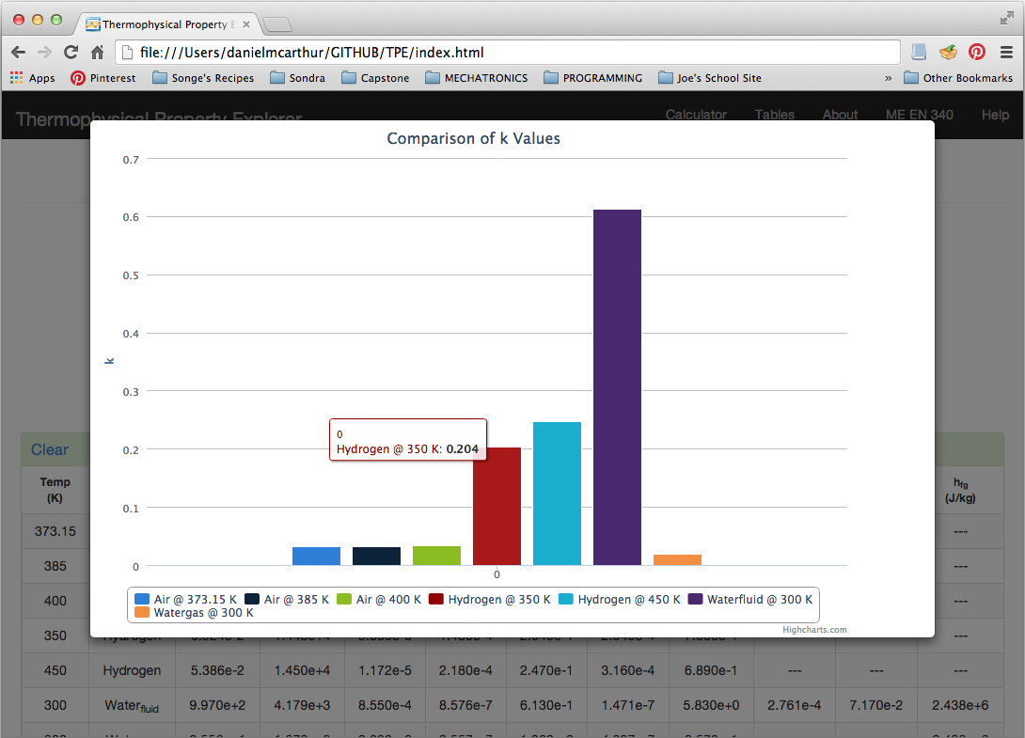
Key Features
Animated charts compare properties for different materials

Slide 6
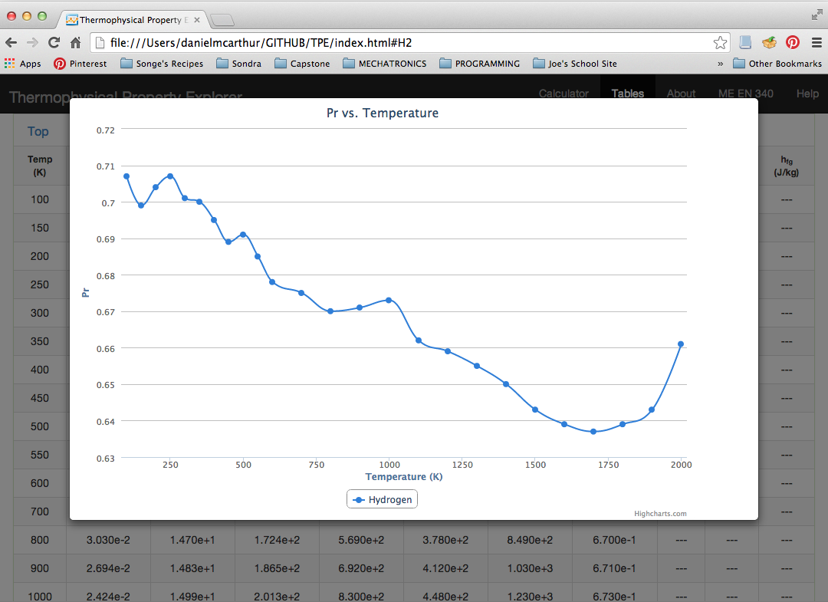
Key Features
Animated plots help visualize how properties change with temperature

Slide 7
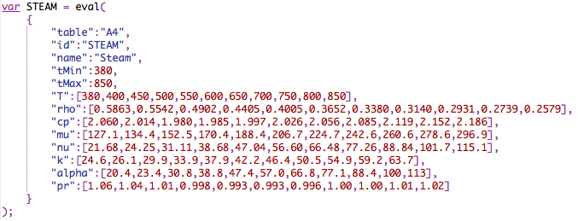
Key Features
Pure HTML/Javascript; code can run on a server, or locally on any OS
Properties listed in standard SI units to help avoid computational errors
All data stored in JSON so it can be updated/edited easily

Slide 8
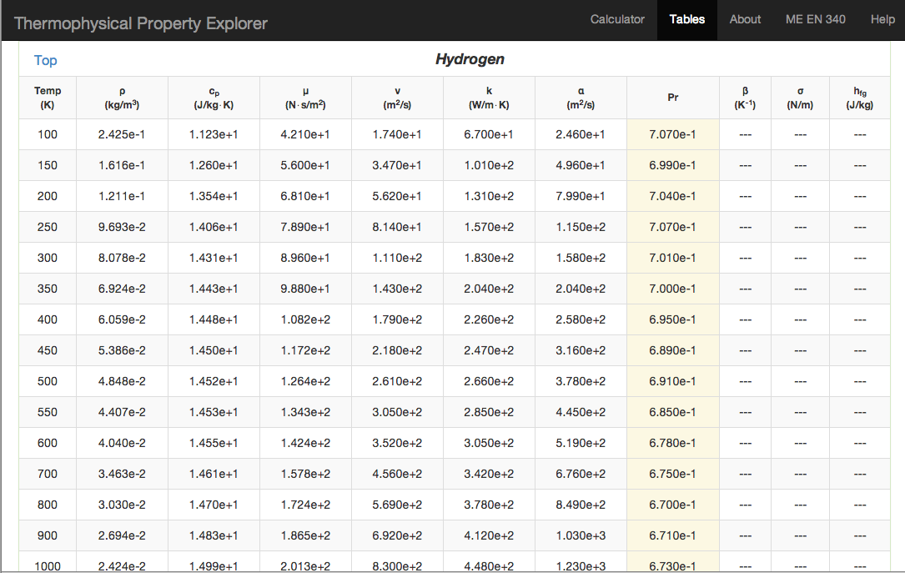
Key Features
Simple User Interface
Rows Highlight for Deletion:
Columns Highlight for Plotting:

Slide 9
Setup Instructions
Download and unzip the TPE folder
Place the TPE folder in a known path on your web server or local file system
(e.g. http://students.cs.byu.edu/~danielrm/TPE)
Open index.html in a web browser (Google Chrome for best results)

