Slide 1
LabVIEW – TP Calculator
Colin Lacey ME 340-2 Winter 2014

Slide 2
Creating a Thermophysical Properties Calculator in LabVIEW
Advantages:
Graphical environment allows fast programming
Built-in functions for handling spreadsheets and interpolation
User interface very easy to set up
Plotting data is very simple
Inherently handy for touch controls
Disadvantages:
Run-time libraries (or development environment) required for execution
Greek symbols not natively supported (used pictures instead)
Must be recompiled to run on alternate OS

Slide 3
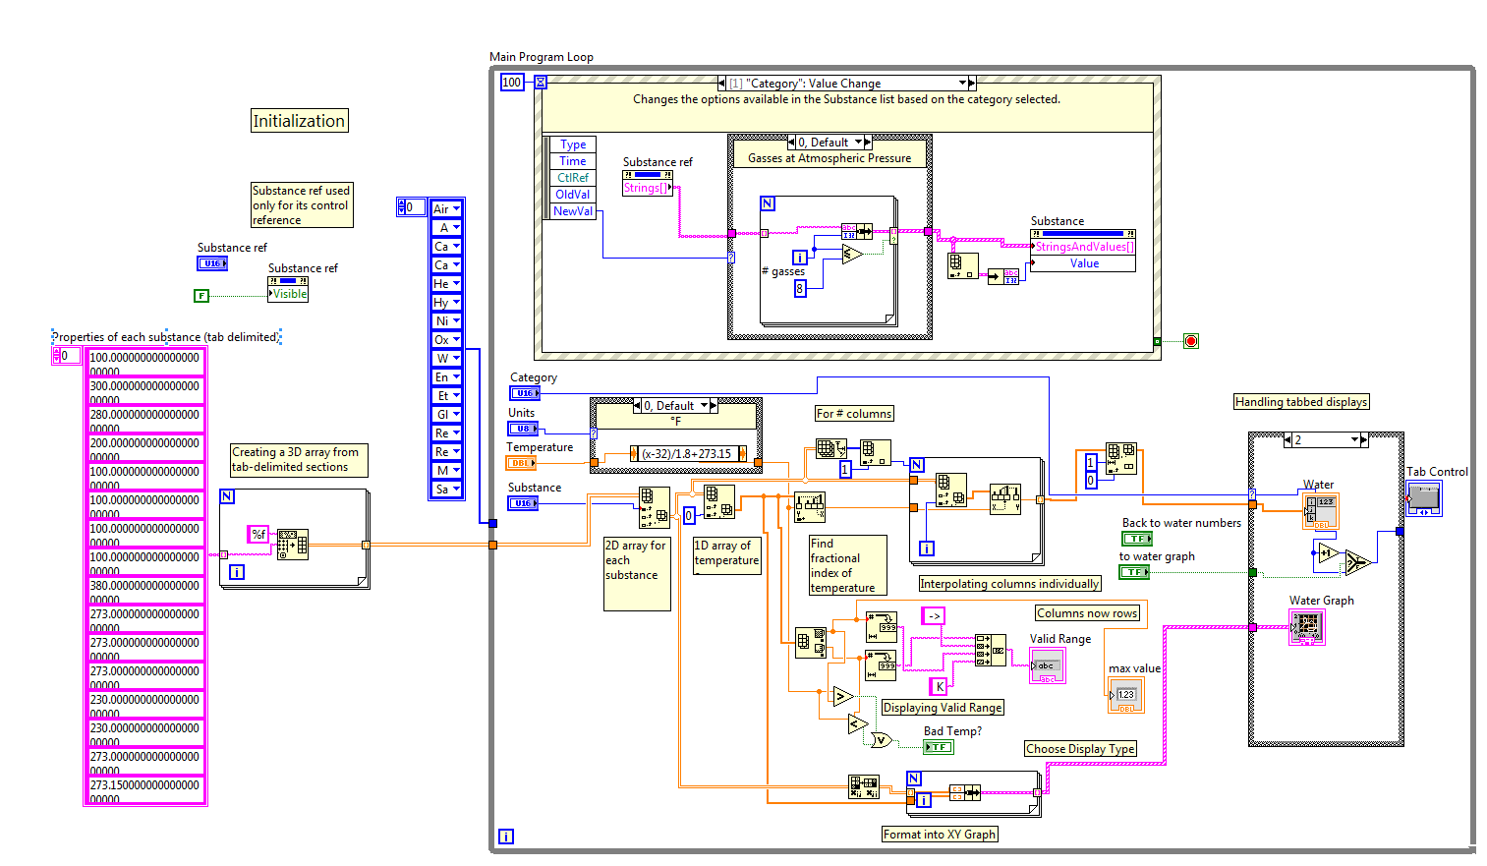
Source Code

Slide 4
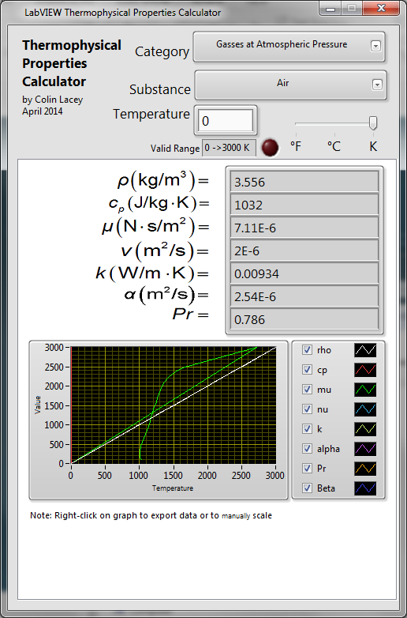
User Interface
Employs separate tabs for each category
Different properties reported
Graphs properties as function of temperature
Allows for °F or °C input, as well as Kelvin
Does away with using kJ as units
Has an LED to indicate out-of-range values

Slide 5
Result
Submitted as both .exe and .vi file
Choose between convenient use and the ability to customize
Problems/Bugs
The graphs don’t all autoscale properly
Some of the reported bounds for the temperature are incorrect

