Slide 1
Cooling Hot Chocolate in an insulated container
James Jackson and Jordan Peterson

Slide 2
Question:
Does the speed with which you stir hot chocolate in an insulated cup affect the time it takes to cool?

Slide 3
Objective:
Find the heat lost by a fluid in an insulated cup over five minutes for the following conditions:
No stirring
Stirred with one revolution per second
Stirred with two revolutions per second
Stirred with three revolutions per second

Slide 4
Problem Setup:
Insulated cup→ Assume no heat transfer through sides or bottom
No air velocity → Assume only free convection and radiation
Initial Fluid Temperature – varies, 65-70 degrees Celsius
External Temperature – 20.3 degrees Celsius
Free convection over flat plate
Water has emissivity of .98

Slide 5
Procedure/Setup:
Water was heated in a microwave until it reached approximately 70 degrees Celsius.
The temperature of the water and ambient air were taken with thermocouples.
The water was stirred at a constant rate according to each condition.
Temperature was recorded every 30 seconds.

Slide 6
Results:
We found that stirring the liquid made absolutely no difference to the cooling speed.
This was true no matter how fast we stirred the fluid.
This makes sense, because there is a relatively small area over which heat transfer through convection induced by stirring could take place. In addition, even at a relatively fast stirring speed, the fluid velocity is still fairly low, resulting in a low convection coefficient.

Slide 7
Mathematical Model:
Q_{rad}+Q_{conv,free}+Q_{conv,stir}=ΔE_{water}+ΔE_{plastic}
tA_{s}[h(T_{s}-T$∞$)+εσ(T_{s}⁴-T$∞$⁴)]+Q_{conv,stir}=(mcΔT)_{water}+(mc ΔT)_{plastic}
(This is an approximation, because ΔT_{s} is relatively small over the interval)
g=9.8 , β=2.39E-3 , ν=20.06E-6 , α=28.6E-6 , L=A/P= .015875
Ra=$\frac{gβ\left(Ts−T∞\right)L^{3}}{vα}=$8200
Nu=.54(Ra)^{1/4} eq. 9.30
Nu=5.126
h=k*Nu/L → h=9.49
t=300
5800J + Q_{conv,stir} = 5800J → Q_{conv,stir}=0

Slide 8
Conclusion:
Because the free convection and radiation are responsible for the heat transfer in the fluid, stirring the liquid has no effect on the cooling rate, no matter how quickly it is stirred.
Further investigation could be performed into the effect of stirring the liquid while blowing on the liquid, essentially increasing the convection coefficient in forced convection.

Slide 9
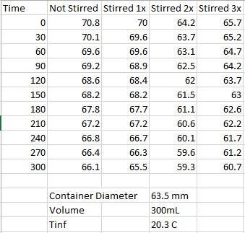
Appendix:

