Slide 1
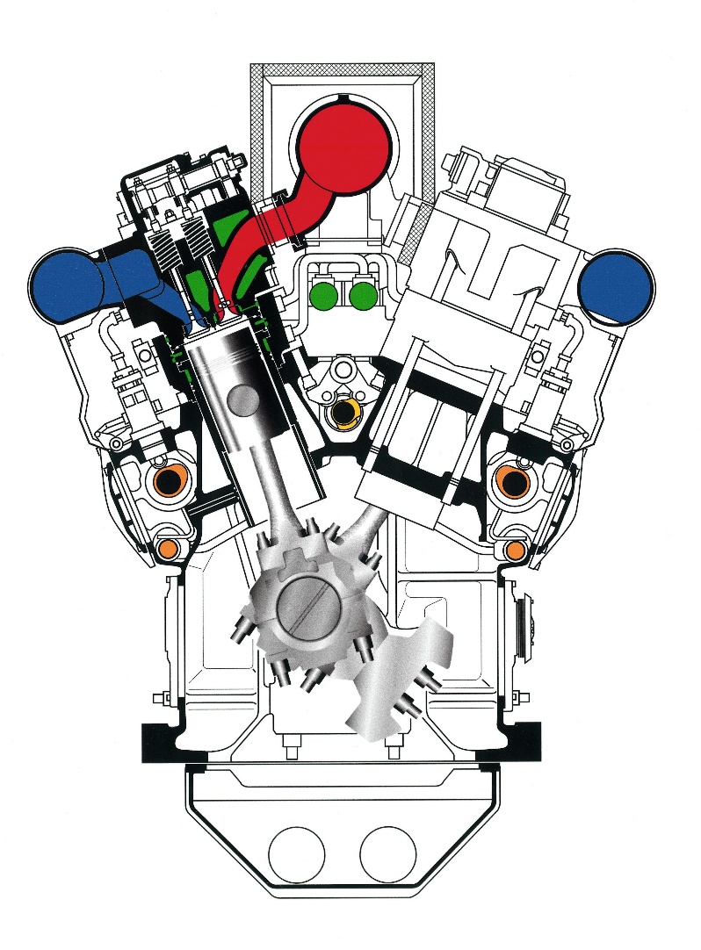
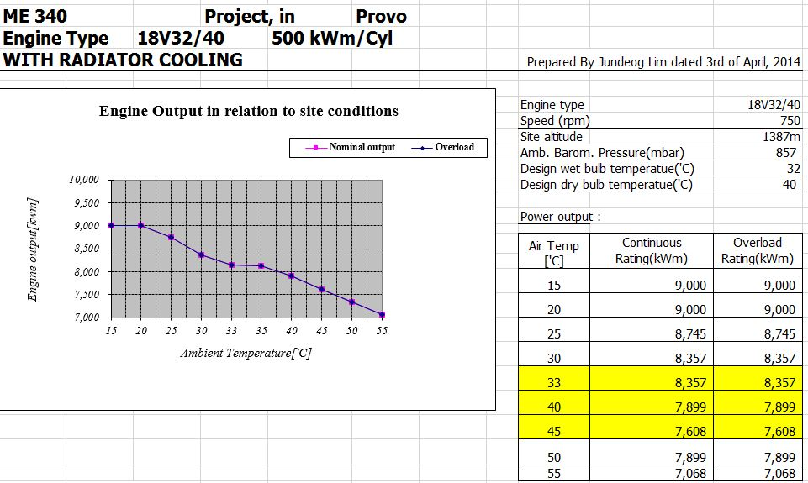
Calculation of Power Rating for MAN Diesel Engine
Resource: http://www.mandieselturbo.com/projectguidesengine/data/32-44CR%20IMO%20Tier%20II%20%E2%80%93%20Marine.pdf

Slide 2
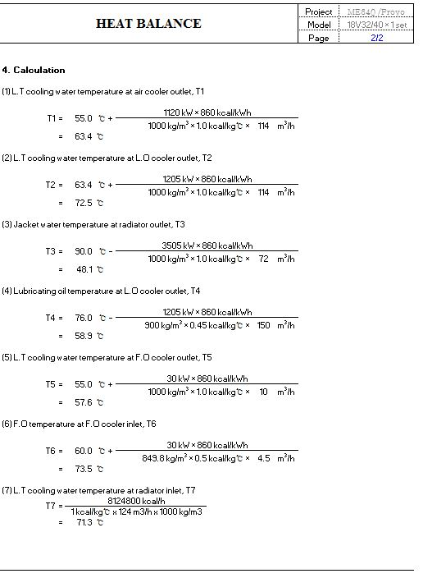
Calculation of Heat Balance for MAN Diesel Engine

